Slide 1
u3a
11th December 2025
Puns, wordplay, jokes …
Liz Swinbank et al

Slide 2
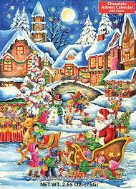
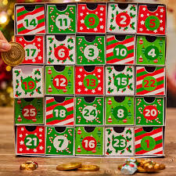

Slide 3
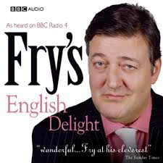
Broadcast December 2007

Slide 4
Fry’s current puns - and more
Pun Punalua Punce Punch
Puncheon Punctate Punctilio
Punctual Punctuate Puncture Pundit
Pundigrion Pundonor Pungent Punic
Punish Punjabi Punk Punka(h)
Punnet Punt Punty Puny

Slide 5
Pun
to pound, to ram, to consolidate by ramming
Pun
to play upon words alike or nearly alike in sound but different in meaning.
A late 17 C word, origin unknown. Italian puntiglio (fine point) has been conjectured

Slide 6
Pundigrion
There is one meaning in OED's entry for the noun pundigrion. This word is now obsolete. It is last recorded around the 1820s.
The earliest known use of the noun pundigrion is in the late 1600s. OED's earliest evidence for pundigrion is from 1673, in the writing of J. Dare.
pundigrion is perhaps a variant or alteration of another lexical item. Perhaps a borrowing from Italian.
Etymons: punctilio n.; Italian puntiglio.
https://www.oed.com/dictionary/pundigrion_n

Slide 7
Fry’s current puns - and more
Pun
Punalua A system of group marriage (Hawaii)
Punce An effeminate man (Australia)
Punch Hook-nosed puppet; drink; to prod, hit
Puncheon A dagger
Punctate Dotted, pitted
Punctilio A nice point in behaviour
Punctual Exact in keeping time
Punctuate To mark with points
Puncture Pricking
Pundit A learned person (Hindi)

Slide 8
Pundigrion
Pundonor A point of honour
Pungent Sharp, pricking, painful, sarcastic
Punic Of ancient Carthage; deceitful
Punish To cause someone to suffer for an offence
Punjabi Person or language of Punjab, India
Punk Prostitute; foolish person; tinder
Punka(h) Palm leaf mechanical fan (Hindi)
Punnet Small shallow basket for fruit
Punt Flat-bottomed boat; Irish pound; to kick
Punty Rod used to handle molten glass
Puny Inexperienced (Shak.); stunted; feeble

Slide 9
Fry’s current puns - and more
Synonyms
Two or more words or expressions of the same language that have the same or nearly the same meaning in some or all senses.
Polynyms
Objects that have more than one name
Homonyms
Words with different meanings that are either homophones or homographs or both
Homophones - identical pronunciation but different meanings
Homographs - identical spelling but different meanings

Slide 10
Puns in Shakespeare
In Romeo and Juliet Mercutio asks Romeo to dance at Capulet’s banquet but Romeo refuses. He says that he doesn’t have ‘nimble soles’ like those on Mercutio’s shoes, but that he has ‘a soul of lead.’
Mercutio, stabbed by Tybalt and bleeding to death, tells his companions that he may be a joker, but ‘ask for me tomorrow and you shall find me a grave man.’
https://nosweatshakespeare.com/shakespeare-puns/

Slide 11
Puns in Shakespeare
According to linguist David Crystal, many of Shakespeare’s puns are lost on modern audiences due to changes in pronunciation.
A Midsummer Night’s Dream, Act 5, Scene 1
Demetrius: No die, but an ace for him.
Ace at the time would have sounded like ass (donkey).
Troilus and Cressida, Act 1, Scene 2
Thersites: But yet you look not well upon him; for, whomsoever you take him to be, he is Ajax.
At the time, Ajax would have been pronounced a jakes.
https://www.independent.co.uk/arts-entertainment/theatre-dance/five-shakespeare-puns-ruined-by-modern-english-a6876931.html

Slide 12
Puns in Shakespeare
Hamlet asks a gravedigger, who is standing in a grave, whose grave he is digging.
The gravedigger: Mine, Sir.
Hamlet: I think it be thine indeed, for thou liest in it.
Richard III
Now is the winter of our discontent
Made glorious summer by this sun of York
https://nosweatshakespeare.com/shakespeare-puns/

Slide 13
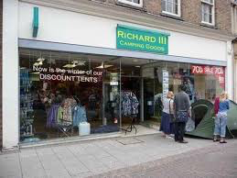

Puns in Shakespeare

Slide 14
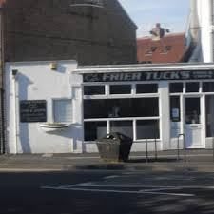
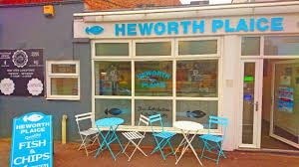

Slide 15



Slide 16
Holorimes
Luc Étienne
« Danse, prélat ! L'abbé t'apprit l'air en plain-chant !
Dans ce pré-là, la bête a pris l'air en pleins champs. »
Jacques Prévert
« Dans ces bois automnaux, graves et romantiques,
Danse et bois aux tonneaux, graves et rhums antiques. »
Louise de Vilmorin
« Étonnamment monotone et lasse
Est ton âme en mon automne, hélas ! »

Slide 17
Holorimes
1. Les petits pois sont rouges ('Peas are red') is a pun on Les petits poissons rouges ('Little red fish')
2. À deux mains ('By/at two hands') is a pun on À demain ('until tomorrow')
3. À toute allure ('At full speed') is a pun on À toute à l'heure ('See you in a bit')
4. Les mots rendent les cris vains ('Words render cries in vain') is a pun on Les mots rendent l'écrivain ('Words make the writer')
https://learnfrenchwithalexa.com/blog/french-puns-to-make-you-laugh

Slide 18
10 Hilarious French Puns & Translation & Audio Pronunciation
Monsieur et madame Nastik ont un fils, comment s’appelle-t-il?
– Jim.
Monsieur et Madame Ouzi ont un fils, comment s’appelle-t-il?
– Jacques.
Monsieur et Madame Tommy ont une fille, comment s’appelle-t-elle?
– Anna.
https://www.frenchtoday.com/blog/french-vocabulary/puns-in-french/

Slide 19
A Computational Model of Linguistic Humor in Puns
Cogn Sci. 2015 Jul 31;40(5):1270–1285.
Abstract Humor plays an essential role in human interactions. Precisely what makes something funny, however, remains elusive. While research on natural language understanding has made significant advancements in recent years, there has been little direct integration of humor research with computational models of language understanding. In this paper, we propose two information‐theoretic measures—ambiguity and distinctiveness—derived from a simple model of sentence processing. We test these measures on a set of puns and regular sentences and show that they correlate significantly with human judgments of funniness. Moreover, within a set of puns, the distinctiveness measure distinguishes exceptionally funny puns from mediocre ones. Our work is the first, to our knowledge, to integrate a computational model of general language understanding and humor theory to quantitatively predict humor at a fine‐grained level. We present it as an example of a framework for applying models of language processing to understand higher level linguistic and cognitive phenomena.
15 pages 8 footnotes 62 references

Slide 20
A Computational Model of Linguistic Humor in Puns
…
We collected 435 sentences consisting of phonetic puns and regular sentences that contain phonetically ambiguous words. We obtained the puns from a website called “Pun of the Day” (http://www.punoftheday.com), which at the time of collection contained over a thousand puns submitted by users. We collected 40 puns where the phonetically ambiguous word has an identical homophone, for example “hare.”
...
We obtained funniness ratings for each of the 435 sentences. We asked 100 participants on Amazon's Mechanical Turk to rate the 195 sentences that contain identical homophones. Each participant read roughly 60 sentences in random order, counterbalanced for the sentence types, and rated each sentence on funniness (“How funny is this sentence?”) on a scale from 1 (not at all) to 7 (extremely).
...

Slide 21
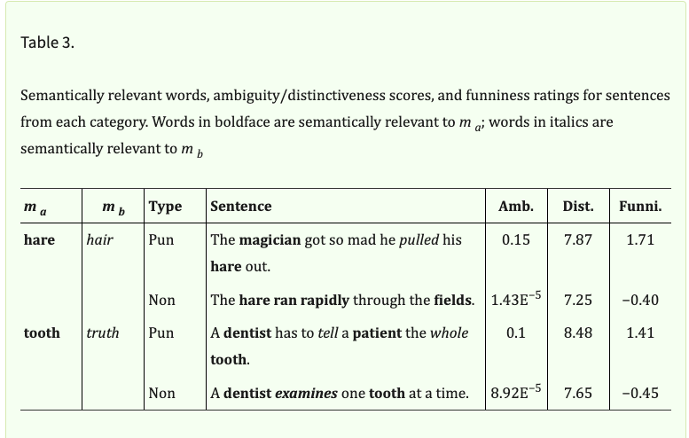
A Computational Model of Linguistic Humor in Puns

Slide 22
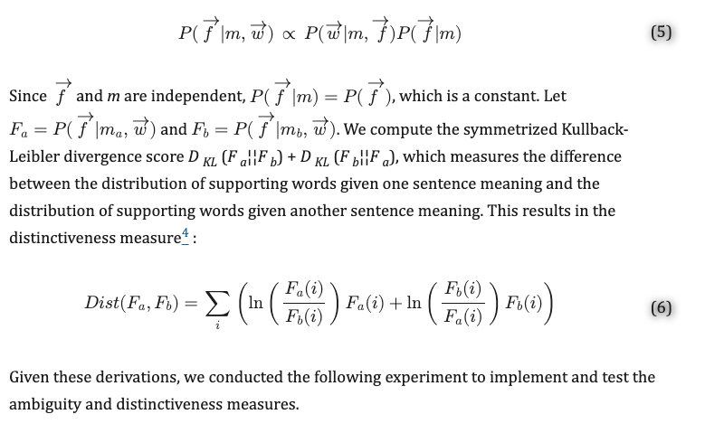
A Computational Model of Linguistic Humor in Puns
https://pmc.ncbi.nlm.nih.gov/articles/PMC5042108/

Slide 23
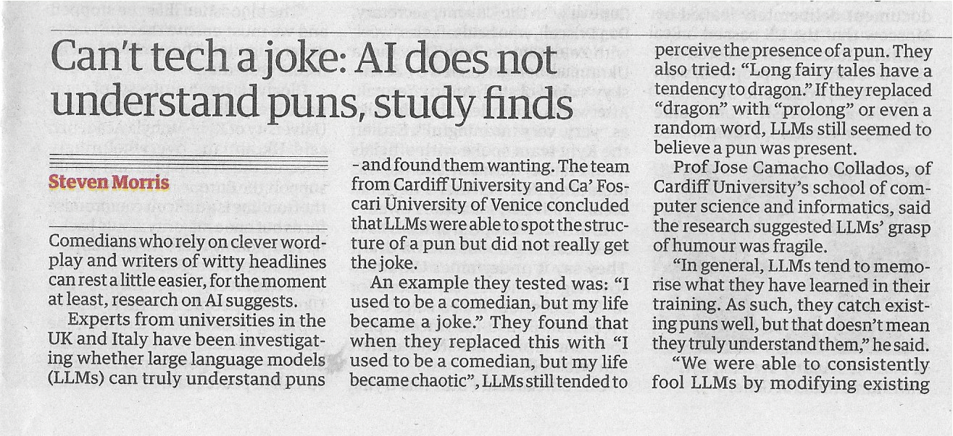
The Guardian, 24 November 2025

Slide 24
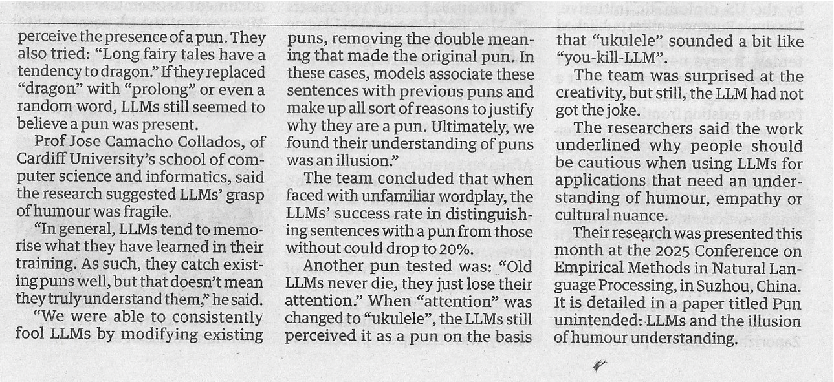
The Guardian, 24 November 2025

Slide 25
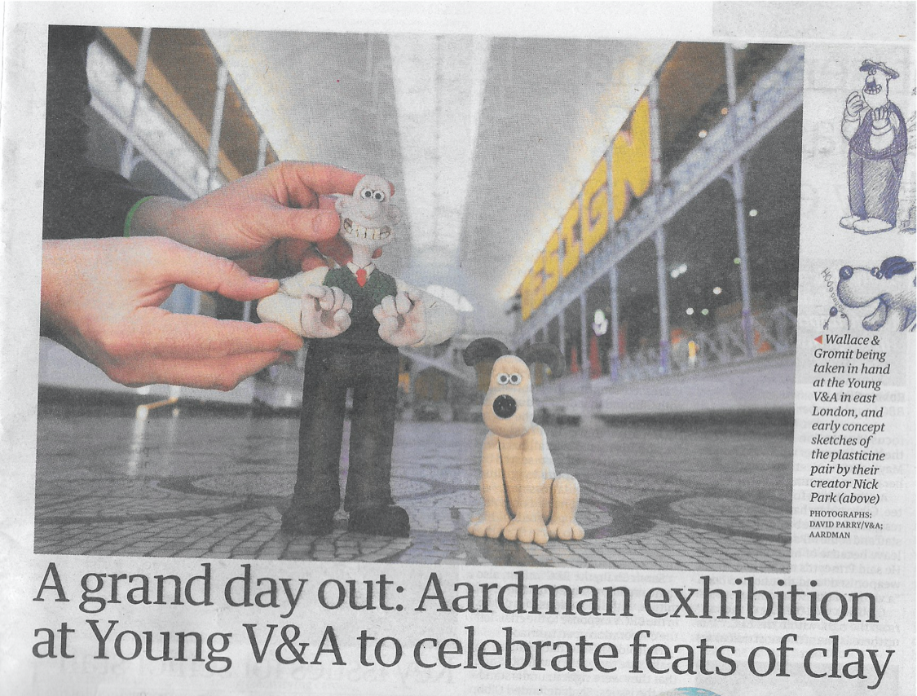
The Guardian, 25 November 2025

Slide 26
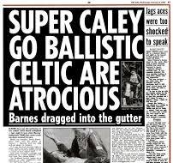
Inverness Caledonian Thistle vs Glasgow Celtic
Scottish Sun, February 2000

Slide 27
