Slide 1
u3a
14 March 2024
As Shakespeare said …
Liz Swinbank

Slide 2
As Shakespeare said …
Shakespeare’s language
Pronunciation
New words and expressions?
False friends
Insults

Slide 3
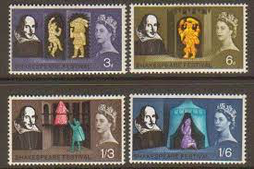
William Shakespeare
1564 –1616

Slide 4
Pronunciation
YouTube video of actor Ben Crystal giving Hamlet’s ‘To be or not to be’ speech using Original Pronunciation (OP) as it would have been spoken in Shakespeare’s time
https://www.youtube.com/watch?v=qYiYd9RcK5M
Ben Crystal’s father is the linguist David Crystal

Slide 5
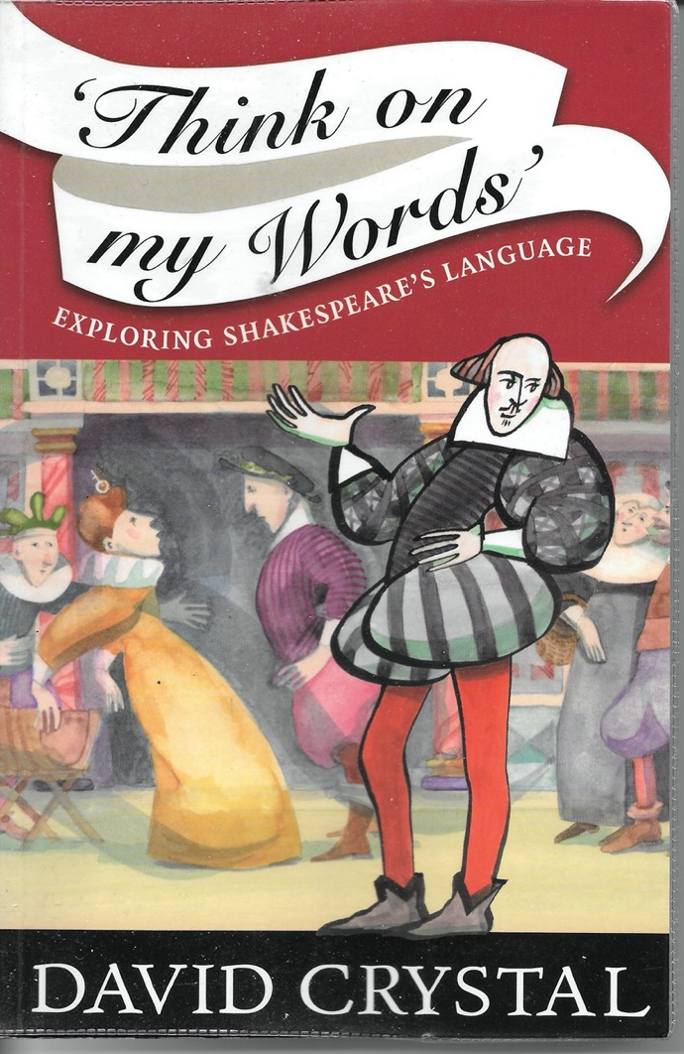

Slide 6
Inventions?
Shakespeare is credited with the first recorded use of up to about 2000 words (1685, 1392, 2034 - depending on who is writing about it).
‘New’ words attributed to Shakespeare include:
Barefaced Castigate Obscene Frugal
Countless Fretful Hint

Slide 7
Inventions?
Some WS inventions are idiosyncratic:
Othello
To be once in doubt Is once to be resolved. Exchange me for a goat When I shall turn the business of my soul To such exsufflicate and blown surmises, Matching thy inference. ’Tis not to make me jealous To say my wife is fair, feeds well, loves company, Is free of speech, sings, plays, and dances well.
(Othello, Act 3 Scene 3)
exsuffulicate puffed up

Slide 8
Inventions?
Simple Marry, sir, I come to speak with Sir John Falstaff from Master Slender.
Host There’s his chamber, his house, his castle, his standing-bed and truckle-bed. ’Tis painted about with the story of the Prodigal, fresh and new. Go, knock and call. He’ll speak like an Anthropophaginian unto thee. Knock, I say.
(The Merry Wives of Windsor, Act 4 Scene 5)
Anthropophaginian Cannibal

Slide 9
Inventions?
Ghost
Thus was I, sleeping, by a brother's hand
Of life, of crown, of queen at once dispatched,
Cut off even in the blossoms of my sin,
Unhousled, disappointed, unaneled,
No reckoning made, but sent to my account
With all my imperfections on my head.
Oh, horrible, oh, horrible, most horrible!
(Hamlet, Act 1 Scene 5)

Slide 10
Unhousled, disappointed, unaneled
Unhousled Cast out from home ??
Naked ??
Thrown from a horse ??
Unhousled = Without the Eucharist
First known use of unhousled is by Thomas More in 1532

Slide 11
Unhousled, disappointed, unaneled
David Crystal has Shakespeare first using
… disappointed, unaneled,
But in the Oxford English Dictionary:
The earliest known use of the adjective disappointed is in the mid 1500s.
OED's earliest evidence for disappointed is from around 1550, in the writing of John Hall, surgeon and author.
https://www.oed.com/dictionary/disappointed_adj
Hamlet was written about 1599-1601

Slide 12
Unhousled, disappointed, unaneled
Unhousled = without the Eucharist
Disappointed = unprepared, unfurnished
Unaneled = without having received the last sacrements

Slide 13
Inventions?
Agamemnon
Princes
What grief hath set the jaundice on your cheeks?
The ample proposition that hope makes
In all designs begun on earth below
Fails in the promised largeness: checks and disasters
Grow in the veins of actions highest rear’d,
As knots, by the conflux of meeting sap,
Infect the sound pine and divert his grain
Tortive and errant from his course of growth
(Troilus and Cressida, Act 1 Scene 3)

Slide 14
Inventions?
Troilus and Cressida, written around 1600-1603, has many words first recorded by WS:-
untimbered importless insisture
neglection scaffoldage exposure
rejoindure embrasure multipotent
oppugnancy protractive persistive
"No other play has so many ..." (David Crystal)

Slide 15
Idiomatic expressions
WS works include several idiomatic expressions as used today. eg:-
With bated breath
To the manner born
Tower of strength
Foregone conclusion
Play fast and loose

Slide 16
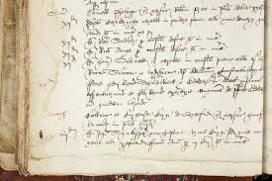
False friends
In 1552 William’s father, John Shakespeare - a tanner and glover - and two associates paid a fine of 12d for making a mukhyll on a street

Slide 17
Fine
Modern English
a penalty that a court of law or other authority decides must be paid as punishment for a crime or other offence
16th Century English
“The meanings of a lot of these words have changed over the last 500 years. A fine was simply a charge, a rent or rates. There was absolutely no moral imputation to John Shakespeare’s fine at all. Stratford muckhills in his lifetime were a rentable resource, for which the town could collect taxes.”
https://www.theguardian.com/culture/2024/feb/23/shakespeare-expert-overturns-fly-tipper-myth-about-playwrights-father

Slide 18
Fine
Some City Livery Companies continue to use fine in its earlier sense:-
“Liverymen must pay a fine on admission to the Livery … This includes VAT, a silver Livery medal and admission to the Court Luncheon following the ceremony at which new members are clothed “as of the Livery”. The admission fine is effectively a demonstration of commitment to the Company, which in turn provides a lifetime of membership, subject to continuing payment of the annual subscription (Quarterage) each year...”
https://www.spectaclemakers.com/membership/admission-to-the-livery

Slide 19
False friends
Gloucester
Those uncles which you want were dangerous:
Your grace attended to their sug’red words
But look’d not on the poison of their hearts.
God keep you from them and and such false friends!
Prince
God keep me from false friends! But they were none.
(Richard III, Act 3 Scene 1)

Slide 20
Want
Modern English
desire wish need require
16th Century English
lack be without
Cordelia
I want that glib and only art
To speak and purpose not
(King Lear, Act 1 Scene 1)

Slide 21
Doubt
Modern English
feel unsure about mistrust uncertainty
16th Century English
fear suspect
Hamlet
I doubt some foul play
(Hamlet, Act 1 Scene 2)

Slide 22
False friends
David Crystal lists a Shakespearean false friend for every letter of the alphabet apart from X. These include:
catastrophe teen generous
humorous merely revolve silly
Match these Shakespearean meanings to the words
helpless utterly consider moody
conclusion suffering good mannered

Slide 23
Shakespearean meanings
catastrophe conclusion, end point
teen hurt, distress, suffering
generous well bred, good mannered
humorous moody, temperamental
merely utterly, entirely
revolve consider, meditate
silly helpless, defenceless

Slide 24
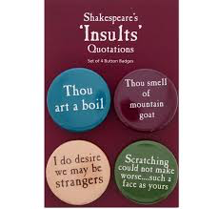
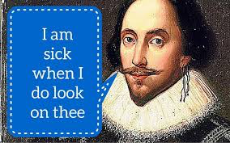
Insults

