Slide 1
u3a
9 May 2024
Idiom
Frances Fletcher and Liz Swinbank

Slide 2
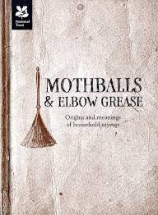
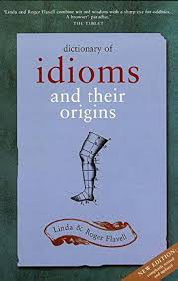

Slide 3
Idiom
From Greek idios: one’s own, peculiar, strange
Idioms break the normal rules of language
semantically, with regard to their meaning
To kick the bucket
syntactically, being inflexible with regard to their grammar
A bucket was kicked

Slide 4
In black and white
In some contexts, black has negative connotations …
To be in someone’s black books
Blackball Blacklisted
The black sheep of the family
… while white is often more positive
White magic White lie

Slide 5
Jokes and word play
‘I’ve got my husband eating out of my hand – it saves such a lot of washing up.’
‘Waiter – bring me something to eat – I could eat a horse’
’ You couldn’t have come to a better place, sir’
‘What goes “ha ha bonk”?’
‘Someone laughing their head off’
‘What lies on the sea bed and twitches?’
‘A nervous wreck’

Slide 6
Jokes and word play
There was a young lad of Montrose
Who had pockets in none of his clothes
When asked by his lass
Where he carried his brass
He replied ‘I just pay through the nose’

Slide 7
Pay through the nose
Idioms are harder to trace to their “roots” than words.
… we cannot account for the odd phrase unless we succeed in reconstructing the circumstances in which it was coined. A product of popular culture? An obscene joke from a Restoration comedy? A borrowing from the language of thieves?
The Internet supplies those who look for the history of pay through the nose with four or five explanations from books bearing the generic title Phrase Origins. All of them, regardless of their reliability, have a fatal flaw: they do not cite their sources. At best, they say it is usually believed or according to legend
Anatoly Liberman
https://blog.oup.com/2010/10/pay-through-the-nose/

Slide 8
Pay through the nose
This is what we can find. “If you were caught stealing in medieval times, they sliced a slit in your nose.” Anywhere (or only in England?) in the Middle Ages at any time? “In medieval times, when the Jews were being bled for money, any objection by them to paying was greeted with a slitting of their noses.”
...
Then, again, ‘... this was originally a common expression on board ship: ‘Pay out the cable’, ‘pay out handsomely’. The nose of a ship is, of course, the bow; its nostrils are the hawse holes on either side.
Anatoly Liberman
https://blog.oup.com/2010/10/pay-through-the-nose/

Slide 9
Idioms
Break the normal rules of language
semantically, with regard to their meaning
syntactically, being inflexible with regard to their grammar
Are harder to trace to their “roots” than words

Slide 10
Why it’s impossible to get your knickers in a twist in France
“ I have just spent some weeks in France, and have encountered a recurrent problem: how does one cope when translating English idiomatic words and phrases into French? What is one to do about “taking the biscuit”? Or, to cite gastronomic examples: a piece of cake, a dog’s breakfast, to cut the mustard, to chicken out, old bean, to spill the beans, egg on your face, a red herring, the best thing since sliced bread, in the soup and one sandwich short of a picnic? Understandably the French don’t have frogs in their throats, they have cats.
...
Bernard Richards, The Daily Telegraph, 2 March 2024
http://digitaleditions.telegraph.co.uk/data/1628/reader/reader.html?social#!preferred/0/package/1628/pub/1628/page/166/article/NaN

Slide 11
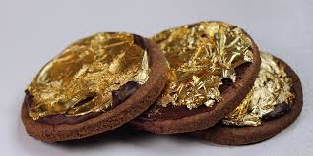
Food-related
Many example, including …
Cheesed off Cool as a cucumber
As sure as eggs is eggs Cut the mustard
In a jam Fork out Square meal
Take the gilt off the gingerbread
Dine with Duke Humphrey
Leave some for the Duke of Rutland

Slide 12
Food-related
Though little coin thy purseless pocket line,
Yet with great company thou are taken up;
For often with Duke Humphrey thou dost dine
And often with Sir Thomas Gresham sup.
Epigram on a loafer
in
Quodlibets, Robert Hayman, 1628

Slide 13
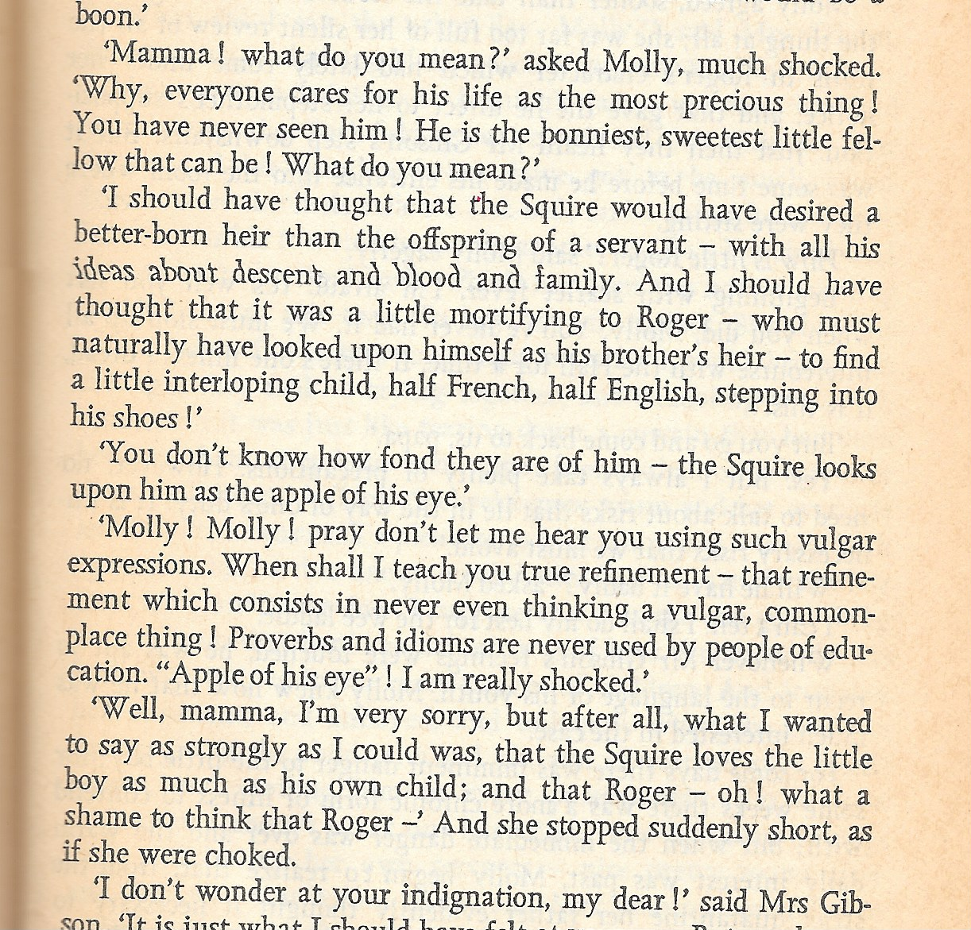
Wives and Daughters Elizabeth Gaskell, 1866

Slide 14
The apple of his eye
'Apple' originally referred to the pupil, or occasionally to the whole eyeball.
…
In A Midsummer Night’s Dream, Oberon has acquired a flower that was once hit by Cupid’s arrow, and drops juice of this flower into a young sleeping man's eyes:
"Flower of this purple dye,
Hit with Cupid's archery,
Sink in apple of his eye".
https://en.wikipedia.org/wiki/Apple_of_my_eye

Slide 15
The apple of his eye
The idiomatic use occurs in the King James Bible (1611):
Psalm 17:8: "Keep me as the apple of the eye, hide me under the shadow of thy wings".
Proverbs 7:2: "Keep my commandments, and live; and my law as the apple of thine eye".
However, this comes from English idiom, not the original Biblical Hebrew.
https://en.wikipedia.org/wiki/Apple_of_my_eye

Slide 16
Shakespeare
Shakespeare’s works include several idiomatic expressions as used today. eg:-
With bated breath
To the manner born
Tower of strength
Foregone conclusion
Play fast and loose

Slide 17
Anatomical
The apple of his eye
Take it on the chin
Putting one’s foot in it
Giving the cold shoulder
Having a chip on one’s shoulder

Slide 18
Chips
Having a chip on one’s shoulder
A chip off the old block
To chip in
When the chips are down
To have had one’s chips

Slide 19
And more …
Curry favour
Sleep on a clothesline
Send to Coventry

Slide 20
Idioms
Break the normal rules of language
semantically, with regard to their meaning
syntactically, being inflexible with regard to their grammar
Are harder to trace to their “roots” than words
Defy translation between languages

