Slide 2
ENGLISH WORDS ARE NOT ENGLISH
1. As so many have said!
2. Owned or Borrowed?
3. Owned: FAIR
4. Borrowed I – Latin I
5. Borrowed 2 – French (Really??)
6. Borrowed 3 – Latin II
7. The Backlash c1500 – c2000
8. Borrowed 4: French again
9. Borrowed 5: Other languages
10. Well, actually, some English words ARE English!

Slide 3
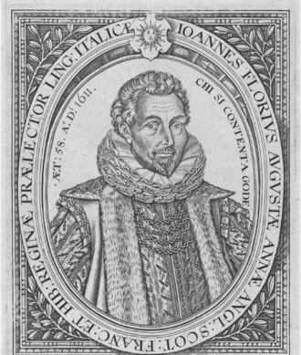
ENGLISH WORDS ARE NOT ENGLISH
1. As so many have said!
John Florio 1552 – 1625, linguist, poet, writer, translator, lexicographer and royal language tutor at the Court of James I.
English is "a language confused, bepieced with other tongues so that if every language had his own words again, there would but few remain for Englishmen".

Slide 4
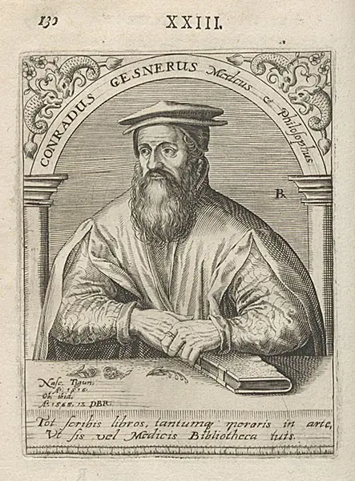
ENGLISH WORDS ARE NOT ENGLISH
1. As so many have said!
Conrad Gessner 1516 – 1565 Swiss physician, naturalist, bibliographer, and philologist.
“Today, English is, of all languages, the most mixed and corrupt".

Slide 5
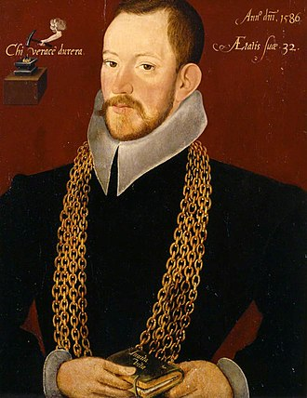
ENGLISH WORDS ARE NOT ENGLISH
1. As so many have said!
Richard Carew 1555 – 1620 Cornish translator and antiquary.
Patching in words from other languages "maketh….(a)
hotch-pot of our tongue" but "this theft of words" is quite acceptable on the grounds that all these words have been used for a very long time and that no-one has ever asked for them back. “The Greeks robbed the Hebrews, the Latins the Greeks and (in a manner) all other Christian Nations the Latine".

Slide 6
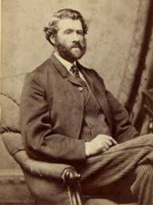
ENGLISH WORDS ARE NOT ENGLISH
1. As so many have said!
John Miller Dow Meiklejohn 1836 – 1902 Scottish academic, journalist and author known for writing school books.
“.....it may be said with truth that: The majority of words in the English tongue are not English. In fact, if we take the Latin language by itself, there are in our language more Latin words than English."

Slide 7
ENGLISH WORDS ARE NOT ENGLISH
1. As so many have said!
2. Owned or Borrowed?
3. Owned: FAIR
4. Borrowed I – Latin I
5. Borrowed 2 – French (Really??)
6. Borrowed 3 – Latin II
7. The Backlash c1500 – c2000
8. Borrowed 4: French again
9. Borrowed 5: Other languages
10. Well, actually, some English words ARE English!

Slide 8
ENGLISH WORDS ARE NOT ENGLISH
2. Owned or Borrowed?
Owned = words that came over the North Sea from the fifth to the eleventh centuries
Borrowed = everything else (the vast majority)

Slide 9
ENGLISH WORDS ARE NOT ENGLISH
1. As so many have said!
2. Owned or Borrowed?
3. Owned: FAIR
4. Borrowed I – Latin I
5. Borrowed 2 – French (Really??)
6. Borrowed 3 – Latin II
7. The Backlash c1500 – c2000
8. Borrowed 4: French again
9. Borrowed 5: Other languages
10. Well, actually, some English words ARE English!

Slide 10
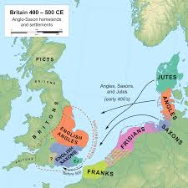
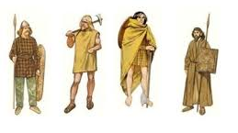
ENGLISH WORDS ARE NOT ENGLISH
3. Owned
‘Owned’ words really means ‘owned meanings’.
The words themselves are shared with Germanic people.

Slide 11
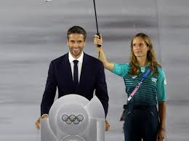
ENGLISH WORDS ARE NOT ENGLISH
3. Owned: FAIR
Anglicism: a characteristic feature of English occurring in another language.
Tony Estanguet , President of the Paris 2024 Organising Committee
The Olympic Spirit requires: "la compréhension mutuelle avec un esprit d'amitié, de solidarité et de fair-play".

Slide 12
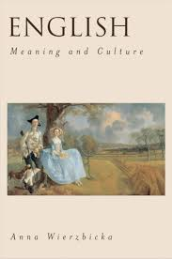
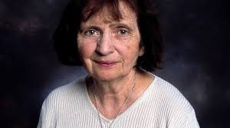
ENGLISH WORDS ARE NOT ENGLISH
3. Owned FAIR
Her daughters used to say ‘To nie fair’
You can’t translate ‘fair’. It is essentially English.
Anna Wierzbicka
But you CAN translate “It’s not fair” - Italian children say ‘Non vale’

Slide 13
ENGLISH WORDS ARE NOT ENGLISH
3. Owned FAIR SHARE
People in Sweden, Norway, Denmark and Iceland share ‘fair’ with us. ‘Fager’or ‘Fagur’
= Beautiful’
= Good (Weather)

Slide 14
ENGLISH WORDS ARE NOT ENGLISH
3. Owned FAIR SHARE
By Extension
From weather to....
Chance 'there's a fair chance that….’
A discussion point 'that's a fair point’
A well-executed arrest of an old-fashioned criminal by an old-fashioned police officer 'it's a fair cop'

Slide 15
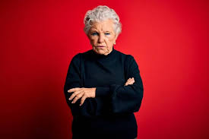
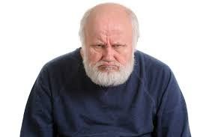
ENGLISH WORDS ARE NOT ENGLISH
3. Owned FAIR
Extension or Misuse?
“Of course the REAL meaning of ‘literally’, ‘disinterested’, ‘decimate’
The real meaning of ‘fair is ‘beautiful’, ‘fair weather’ and all that.
The youth of today (c1380) are using it to mean just and equitable. For goodness sake! What is the world coming to….

Slide 16
ENGLISH WORDS ARE NOT ENGLISH
1. As so many have said!
2. Owned or Borrowed?
3. Owned: FAIR
4. Borrowed I – Latin I
5. Borrowed 2 – French (Really??)
6. Borrowed 3 – Latin II
7. The Backlash c1500 – c2000
8. Borrowed 4: French again
9. Borrowed 5: Other languages
10. Well, actually, some English words ARE English!

Slide 17
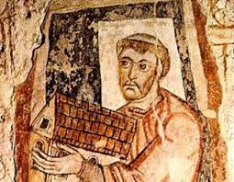
ENGLISH WORDS ARE NOT ENGLISH
4. Borrowed I – Latin I
Seventh century monks
New people, new things
Bishop (biscop) < episcopus
Carpet /Tapestry teped < tapetum

Slide 18
ENGLISH WORDS ARE NOT ENGLISH
4. Borrowed I – Latin I
Seventh century monks
More fashionable words for familiar things
Spoon (or spon) > culcer < coclearium
Gafol > forc(a) < furca

Slide 19
ENGLISH WORDS ARE NOT ENGLISH
1. As so many have said!
2. Owned or Borrowed?
3. Owned: FAIR
4. Borrowed I – Latin I
5. Borrowed 2 – French (Really??)
6. Borrowed 3 – Latin II
7. The Backlash c1500 – c2000
8. Borrowed 4: French again
9. Borrowed 5: Other languages
10. Well, actually, some English words ARE English!

Slide 20
ENGLISH WORDS ARE NOT ENGLISH
5. Borrowed 2 – French (Really??)
OED : words from French are ‘borrowed’
e.g. ‘passage’, on loan since the 12th century

Slide 21
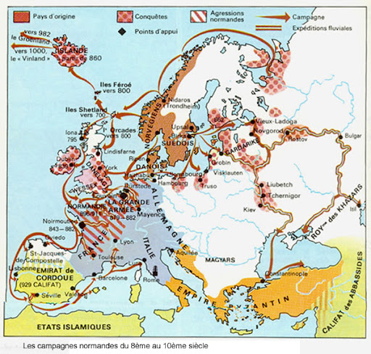
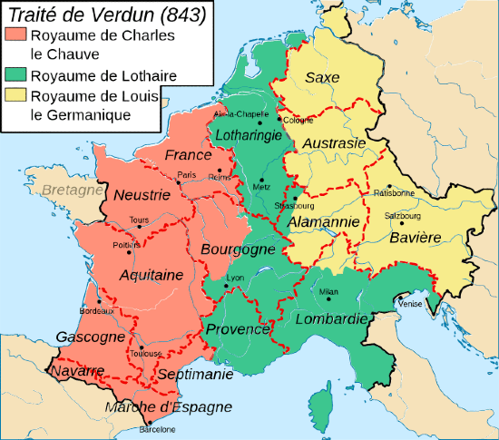
ENGLISH WORDS ARE NOT ENGLISH
5. Borrowed 2 – French (Really??)
1066. Normans (Northmen/Normen) - a hybrid lot: Franco-Gallic Neustrian and Scandinavian.

Slide 22
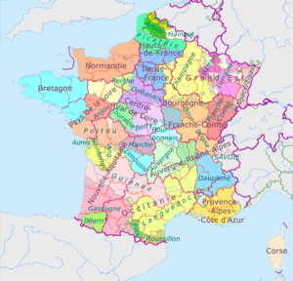
ENGLISH WORDS ARE NOT ENGLISH
5. Borrowed 2 – French (Really??)
Posh Normans’ language - influenced by the language of the Ile de France = French
But were they any good at it?
We know about those who could write – Anglo-French

Slide 23
ENGLISH WORDS ARE NOT ENGLISH
5. Borrowed 2 – French (Really??)
POC/POCK POCS/POCKS/POX
POKE (PIG IN A .....) POKY POCHE
POUCH POACH EMPOCHER EN POCHE
POCHETTE POCKET

Slide 24
ENGLISH WORDS ARE NOT ENGLISH
5. Borrowed 2 – French (Really??)
Norman COT < Norse KOT
Ascot, Nethercot, dovecote
Gallo-Roman -agium > Franco-Neustrian-Norman -age
COT + AGE = COT(T)AGE - Anglo-Norman only
French abandon ‘cot’ (too close to côte and côté, perhaps)

Slide 25
ENGLISH WORDS ARE NOT ENGLISH
5. Borrowed 2 – French (Really??)
But, 1,000 years later, adopt ‘cottage’

Slide 26
ENGLISH WORDS ARE NOT ENGLISH
1. As so many have said!
2. Owned or Borrowed?
3. Owned: FAIR
4. Borrowed I – Latin I
5. Borrowed 2 – French (Really??)
6. Borrowed 3 – Latin II
7. The Backlash c1500 – c2000
8. Borrowed 4: French again
9. Borrowed 5: Other languages
10. Well, actually, some English words ARE English!

Slide 27
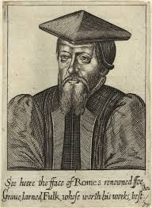
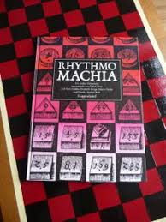
ENGLISH WORDS ARE NOT ENGLISH
6. Borrowed 3 – Latin II
William Fulke and
Ralph Lever
The Most Noble, Auncient, And learned Playe 1563
"more things, than there are words (in English) to express things by".

Slide 28
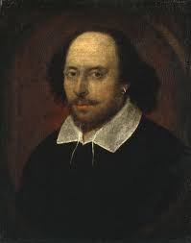
ENGLISH WORDS ARE NOT ENGLISH
6. Borrowed 3 – Latin II
Thousands of words, e.g.
aberration, allusion, anachronism, democratic, dexterity, enthusiasm, imaginary, juvenile, pernicious, sophisticated
Shakespeare used 1,700 Latin-based words that do not appear in previous texts.
He may have heard them, read them or made them up.

Slide 29
ENGLISH WORDS ARE NOT ENGLISH
1. As so many have said!
2. Owned or Borrowed?
3. Owned: FAIR
4. Borrowed I – Latin I
5. Borrowed 2 – French (Really??)
6. Borrowed 3 – Latin II
7. The Backlash c1500 – c2000
8. Borrowed 4: French again
9. Borrowed 5: Other languages
10. Well, actually, some English words ARE English!

Slide 30
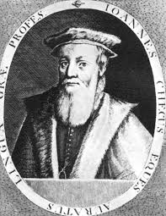
ENGLISH WORDS ARE NOT ENGLISH
7. The Backlash c1500 – c2000
John Cheke (1514-1557) Professor of Greek, University of Cambridge
Can we have a 'clean and pure English, unmixed and unmangled with other tongues’?
In his translation of the Gospels, he wrote 'crossed' not 'crucified'.

Slide 31
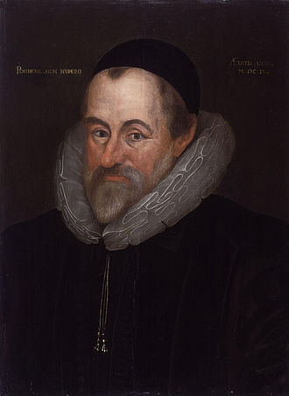
ENGLISH WORDS ARE NOT ENGLISH
7. The Backlash c1500 – c2000
William Camden 1551 – 1623. English antiquarian, historian, topographer, and herald
"This English tongue is extracted, as the nation, from the Germans…".
"the olde English could express most aptly, all the conceiptes of the minde in their owne tongue without borrowing from any"
'express’ - 'gnornian’ 'aptly’ - 'gemet-lice’ 'minde’ – 'ferhþ’

Slide 32
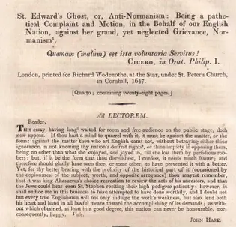
ENGLISH WORDS ARE NOT ENGLISH
7. The Backlash c1500 – c2000
John Hare: 1647 St. Edwards Ghost: or, Anti-Normanisme: being a patheticall complaint and motion in the behalf of our English nation against her grand yet neglected Grievance, Normanisme.
The Saxons "possessed a language superior to Latin and its derivatives" All French words should be purged from the language and replaced with words and terms "from the old Saxon and learned tongues".

Slide 33
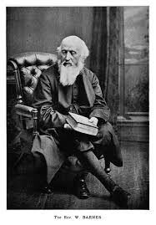
ENGLISH WORDS ARE NOT ENGLISH
7. The Backlash c1500 – c2000
William Barnes 1801 – 1886 English polymath, writer, poet, philologist, priest, mathematician, engraving artist and inventor.
'Foreign-derived words' should be expunged from English and replaced by 'native words'.

Slide 34
ENGLISH WORDS ARE NOT ENGLISH
7. The Backlash c1500 – c2000
An Outline of English Speech-Craft 1878
A comprehensive grammar and explanation of his theory and general approach
An all-holding speechcraft book and outfolding of his thought and broad to-coming.

Slide 35
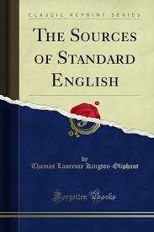
ENGLISH WORDS ARE NOT ENGLISH
7. The Backlash c1500 – c2000
Thomas Laurence Kington Oliphant 1873
The nouveau riche are pretentious with their words: they should clear out Gallicisms and Latinisms from their speech and writing.

Slide 36
ENGLISH WORDS ARE NOT ENGLISH
7. The Backlash c1500 – c2000
Thomas Laurence Kington Oliphant 1873
The train ran with extraordinary velocity.
The train ran very fast.
He did the business with perfect fidelity.
He did the business faithfully.
... the most lively indications of amity
....very kindly
He is in a state of indebtedness.
He owes.
At your wife's behest, I shall no longer seek to underwrite your unfulfilled pledges.

Slide 37
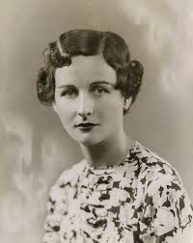
ENGLISH WORDS ARE NOT ENGLISH
7. The Backlash c1500 – c2000
Nancy Freeman-Mitford 1904 – 1973 English novelist, biographer, and journalist.
1956 Noblesse Oblige 'U' and 'Non-U' words
'U' words were generally Germanic/Saxon: napkin, looking glass
Non-U words were 'foreign’: 'serviette’, 'mirror'
'dessert’, 'suite’
pudding √

Slide 38
ENGLISH WORDS ARE NOT ENGLISH
1. As so many have said!
2. Owned or Borrowed?
3. Owned: FAIR
4. Borrowed I – Latin I
5. Borrowed 2 – French (Really??)
6. Borrowed 3 – Latin II
7. The Backlash c1500 – c2000
8. Borrowed 4: French again
9. Borrowed 5: Other languages
10. Well, actually, some English words ARE English!

Slide 39
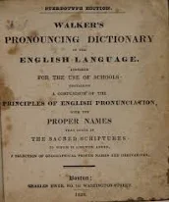
ENGLISH WORDS ARE NOT ENGLISH
8. Borrowed 4: French again
English speakers persist in using French words.........but......
John Walker 1828 Pronouncing dictionary of the English language
The English are prone to 'the most disgraceful imitations of the pronunciations of other nations, specifically French'.

Slide 40
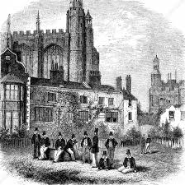
ENGLISH WORDS ARE NOT ENGLISH
8. Borrowed 4: French again
Eton College introduces French to their curriculum
Dites-moi
dights muoy

Slide 41
ENGLISH WORDS ARE NOT ENGLISH
8. Borrowed 4: French again
Three kinds of pronunciation
A à la française: genre, nuance, raison d’etre, faux pas,
crème brulée, pot
B sort of frenchified: parachute, camouflage, fuselage, envelope, enclave
C anglicised: Charles, intelligent, passage, issue, nature
How do you pronounce ‘Bordeaux’?

Slide 42
ENGLISH WORDS ARE NOT ENGLISH
1. As so many have said!
2. Owned or Borrowed?
3. Owned: FAIR
4. Borrowed I – Latin I
5. Borrowed 2 – French (Really??)
6. Borrowed 3 – Latin II
7. The Backlash c1500 – c2000
8. Borrowed 4: French again
9. Borrowed 5: Other languages
10. Well, actually, some English words ARE English!

Slide 43
ENGLISH WORDS ARE NOT ENGLISH
9. Borrowed 5: Other languages
jungle, bungalow, cheetah
Hindi
safari, jumbo
Swahili
pyjamas
Persian
curry
Tamil
okra
Igbo
voodoo
Fon

Slide 44
ENGLISH WORDS ARE NOT ENGLISH
9. Borrowed 5: Other languages
jungle, safari, jumbo, cheetah, voodoo, okra, pyjama have all made it into the OED
BBC News, September 19th 2024
But these words haven’t: ang pow, bagal, bumiputera, coppa, damer, ekwen, haldi , kampong, kolo, pancetta, parmantaz, pecorino, poso poso, provolone, tutufo, wakye

Slide 45
ENGLISH WORDS ARE NOT ENGLISH
1. As so many have said!
2. Owned or Borrowed?
3. Owned: FAIR
4. Borrowed I – Latin I
5. Borrowed 2 – French (Really??)
6. Borrowed 3 – Latin II
7. The Backlash c1500 – c2000
8. Borrowed 4: French again
9. Borrowed 5: Other languages
10. Well, actually, some English words ARE English!

Slide 46
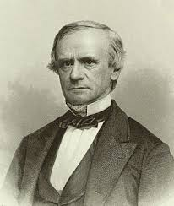
ENGLISH WORDS ARE NOT ENGLISH
10. Well, actually, some English words ARE English!
John Russell Bartlett 1805 – 1886 American historian and linguist.
An Americanism should be "of so-called 'American' origin – that is, that it first came into use in the United States of North America".
An Anglicism should be of English/British origin – that it first came into. use in the British mainland

Slide 47
ENGLISH WORDS ARE NOT ENGLISH
10. Well, actually, some English words ARE English!
Pre-Roman: crag, bin
16th cent. William Tyndale: scapegoat, atonement
17th cent. Thomas Otway: dumbfound
18th cent. Fernando Killigrew: humbug
flabbergasted, thunderstruck, shell-shocked, bowled over, floored, gobsmacked
19th cent. smog
20th – 21st cent. snog, peng, nang, piff, sket, wagwan, wasteman, creps, clapped, leng

Slide 48
ENGLISH WORDS ARE NOT ENGLISH
We gave English to the world!
While all the time the world was actually giving its languages to us.

