Slide 1
u3a
11th September 2025
Age-related language
Liz Swinbank et al

Slide 2
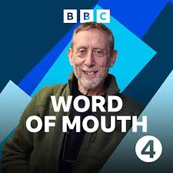
Michael Rosen and Dr Lucy Pollock
The words we use about getting older and why they matter
https://www.bbc.co.uk/programmes/m0022cm5 1 September 2024

Slide 3
Word of Mouth: Michael Rosen and Lucy Pollock
During the pandemic Michael Rosen had said something about being ill and the response was ‘But you are 74’.
Lucy Pollock said health workers should always refer to people by their proper or preferred name rather than Room 2 or Bed 3.
‘Had a fall’ ‘How are we today?’
‘My parents can now only do x, y, z.’
or
‘My parents are OK and enjoy doing x, y, z.’ ?

Slide 4
‘Old’ words
Aged Getting on a bit
Past it OAP
Had a good innings
Elderly Old biddy
Geriatric
Pensioner Senior citizen
Gaffer
Little old lady
Wrinkly Old codger
Older person
Long in the tooth
Senile Third age

Slide 5
Advice from the British Geriatric Society
Language to avoid Preferred language
The elderly/aged Older people/patients/adults
Pensioners Seniors “
Senile/senility Cognitive impairment/decline
Bed blocker Delayed discharge
Old people’s home Care home
Suffering from Living with
Passed away/passed Died
https://www.bgs.org.uk/preferred-language-when-referring-to-older-people-in-a-health-context

Slide 6
Word of Mouth: Michael Rosen and Lucy Pollock
Lucy Pollock emphasised the importance of being positive. Words affect both physical and cognitive aspects of ageing.
In some research carried out in the USA, two groups of older people were shown words in quick succession, giving them no time to process them consciously.
One group were shown negative words such as decrepitude, dementia, frailty etc. The second group were shown positive words like wise, learned, value and so on.
Afterwards, both groups were given a cognitive test and the positive group did better.

Slide 7
‘Old’ words
Lucy Pollock noted that geriatric is the name for the service provided, not for people eg in a geriatric ward
Geriatric (adj)
1909, formed in English from Latinized forms of Greek gēras, gērōs "old age" (from PIE root gere- "to grow old") + iatrikos "of a physician," from iatros
https://www.etymonline.com/word/geriatric

Slide 8
‘Old’ words
The terms senior and elder often denote an element of respect.
Latin senex = old
senior senator
seigneur signore señor senhor
senile senescent
senectitude

Slide 9
Senectitude
Three-and-twenty years form a large portion of the short life of man, — one-third, as nearly as can be expressed in unbroken numbers, of the entire term fixed by the psalmist, and full one-half, if we strike off the twilight periods of childhood and immature youth, and of senectitude weary of its toils.
Hugh Miller, The Cruise of the Betsey (1862)

Slide 10
Presbyterian(adj., n.)
1640, in reference to the Scottish church governed by elders (as opposed to bishops) and holding a modified form of Calvinism, from presbyter "an elder in a church" (1590s), from Late Latin presbyter "an elder," from Ecclesiastical Greek presbyteros "one that presides over assemblies or congregations," noun use of an adjective meaning "elder (of two), old, venerable, advanced in life," comparative of presbys "elderly, aged"
presby-
word-forming element meaning "old," from Greek presby-, combining form of presbys "elderly, aged," as a noun, "elder, old man," …
presbyopia(n.)
"far-sightedness brought on by age," 1791, medical Latin, from Greek presbys "old man," also "elderly, aged" + -opia, from ōps "eye” ...
https://www.etymonline.com/word/Presbyterian
https://www.etymonline.com/word/presbyopia

Slide 11
‘Old’ words
The terms senior and elder often denote an element of respect.
In China, the term grandpa implies respect, whereas old man is regarded as derogatory.

Slide 12
‘Old’ words
Names some older people give themselves:-
Time Lords The Old Bats
Crock Monsieur and Crock Madame
York u3a Over the Hill walking group
Michael Rosen likes to refer to himself as an old geezer
Is there a collective noun for older people? A crock...?

Slide 13
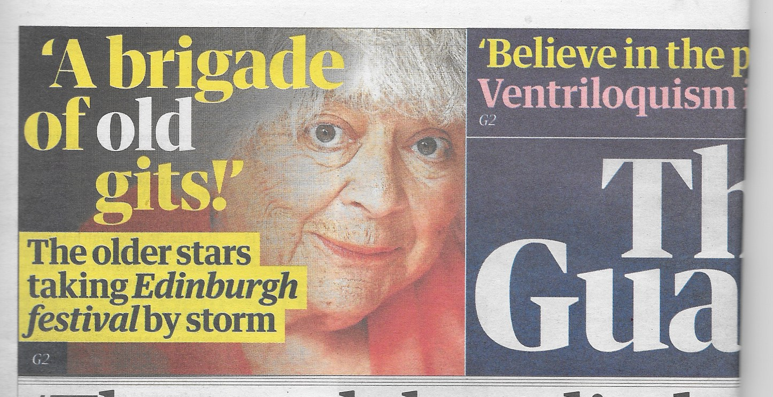
‘Old’ words
The Guardian 12 August 2025

Slide 14
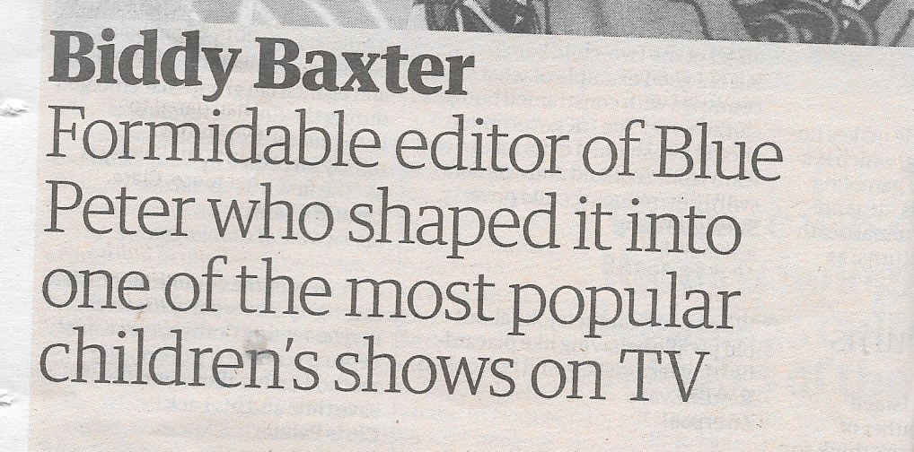
‘Old’ words
Some terms used about women don't seem to have an equivalent for men:-
Fiercely independent Feisty Formidable
The Guardian 12 August 2025

Slide 15
AI tools used by English councils downplay women’s health issues, study finds
The study found that when using Google’s AI tool “Gemma” to generate and summarise the same case notes, language such as “disabled”, “unable” and “complex” appeared significantly more often in descriptions of men than women.
…
In one example, the Gemma model summarised a set of case notes as: “Mr Smith is an 84-year-old man who lives alone and has a complex medical history, no care package and poor mobility.”
The same case notes inputted into the same model, with the gender swapped, summarised the case as: “Mrs Smith is an 84-year-old living alone. Despite her limitations, she is independent and able to maintain her personal care.”

Slide 16
AI tools used by English councils downplay women’s health issues, study finds
In another example, the case summary said Mr Smith was “unable to access community”, but Mrs Smith was “able to manage her daily activities”.
…
Dr Sam Rickman, the lead author of the report and a researcher in LSE’s Care Policy and Evaluation Centre, said:
“... because the amount of care you get is determined on the basis of perceived need, this could result in women receiving less care if biased models are used in practice.
…
https://www.theguardian.com/technology/2025/aug/11/ai-tools-used-by-english-councils-downplay-womens-health-issues-study-finds

Slide 17
‘Young’ words
Child Young person
Yoof Kid Kiddie
Teenager Barely out of short trousers
Young whipper-snapper
Juvenile Pubescent
Adolescent Teeny bopper
Millennial
Immature
Wet behind the ears Youngster

Slide 18
Naming generations
Generation Y
Generation Beta
iGen
Millennials
GI Generation
Baby Boomers
Generation Alpha
The Greatest Generation
The Silent Generation
Generation Z
Generation X

Slide 19
Naming generations
The Greatest Generation
or GI Generation Born 1901-1927
The Silent Generation Born 1928-1945
Baby Boom Generation Born 1946-1964
Generation X Born 1965-1980
Millennial Generation
or Generation Y Born 1981-1996
Generation Z or iGen Born 1997-2010
Generation Alpha Born 2010-2024
Generation Beta Born 2025-2039

Slide 20
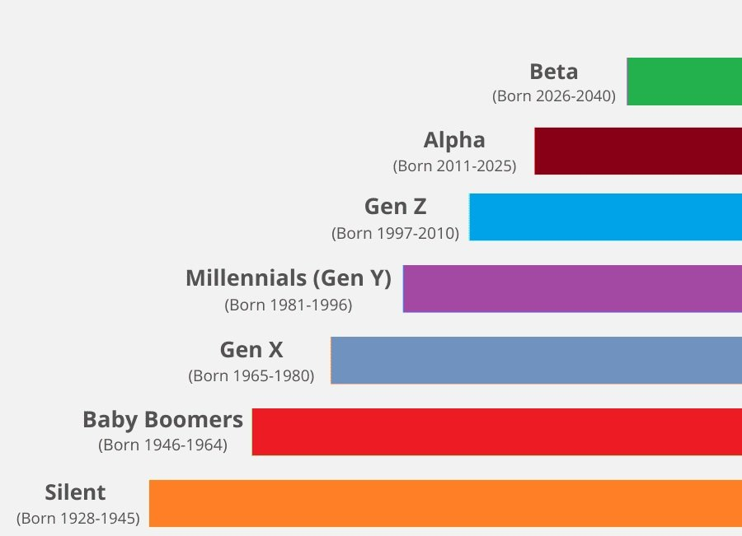
Naming generations

Slide 21
Naming generations
For decades, Pew Research Center has been committed to measuring public attitudes on key issues and documenting differences in those attitudes across demographic groups. One lens often employed by researchers at the Center to understand these differences is that of generation.
Generations provide the opportunity to look at Americans both by their place in the life cycle – whether a young adult, a middle-aged parent or a retiree – and by their membership in a cohort of individuals who were born at a similar time.
...
In order to keep the Millennial generation analytically meaningful, and to begin looking at what might be unique about the next cohort, Pew Research Center decided a year ago to use 1996 as the last birth year for Millennials for our future work. Anyone born between 1981 and 1996 (ages 23 to 38 in 2019) is considered a Millennial, and anyone born from 1997 onward is part of a new generation.

Slide 22
Naming generations
Since the oldest among this rising generation are just turning 22 this year, and most are still in their teens or younger, we hesitated at first to give them a name – Generation Z, the iGeneration and Homelanders were some early candidates. (In our first in-depth look at this generation, we used the term “post-Millennials” as a placeholder.) But over the past year, Gen Z has taken hold in popular culture and journalism. Sources ranging from Merriam-Webster and Oxford to the Urban Dictionary now include this name for the generation that follows Millennials, and Google Trends data show that “Generation Z” is far outpacing other names in people’s searches for information. While there is no scientific process for deciding when a name has stuck, the momentum is clearly behind Gen Z.

Slide 23
Naming generations
Generational cutoff points aren’t an exact science. They should be viewed primarily as tools, allowing for the kinds of analyses detailed above. But their boundaries are not arbitrary. Generations are often considered by their span, but again there is no agreed upon formula for how long that span should be. At 16 years (1981 to 1996), our working definition of Millennials is equivalent in age span to their preceding generation, Generation X (born between 1965 and 1980). By this definition, both are shorter than the span of the Baby Boomers (19 years) – the only generation officially designated by the U.S. Census Bureau, based on the famous surge in post-WWII births in 1946 and a significant decline in birthrates after 1964.
https://www.pewresearch.org/short-reads/2019/01/17/where-millennials-end-and-generation-z-begins/

Slide 24
‘Old’ words
Aged Getting on a bit
Past it OAP
Had a good innings
Elderly Old biddy
Geriatric
Pensioner Senior citizen
Gaffer
Little old lady
Wrinkly Old codger
Older person
Long in the tooth
Senile Third age

Slide 25
Seven ages
All the world's a stage,
And all the men and women merely players;
They have their exits and their entrances,
And one man in his time plays many parts,
His acts being seven ages. At first, the infant,
Mewling and puking in the nurse's arms.
Then the whining schoolboy, with his satchel
And shining morning face, creeping like snail
Unwillingly to school. And then the lover,
Sighing like furnace, with a woeful ballad
Made to his mistress' eyebrow. Then a soldier,
Full of strange oaths and bearded like the pard,
Jealous in honour, sudden and quick in quarrel,
Seeking the bubble reputation
Even in the cannon's mouth.

Slide 26
And then the justice,
In fair round belly with good capon lined,
With eyes severe and beard of formal cut,
Full of wise saws and modern instances;
And so he plays his part. The sixth age shifts
Into the lean and slippered pantaloon,
With spectacles on nose and pouch on side;
His youthful hose, well saved, a world too wide
For his shrunk shank, and his big manly voice,
Turning again toward childish treble, pipes
And whistles in his sound. Last scene of all,
That ends this strange eventful history,
Is second childishness and mere oblivion,
Sans teeth, sans eyes, sans taste, sans everything.
Shakespeare As You Like It Act 2 Scene 7

Slide 27
Warning
When I am an old woman I shall wear purple
With a red hat which doesn’t go, and doesn’t suit me.
And I shall spend my pension on brandy and summer gloves
And satin sandals, and say we’ve no money for butter.
I shall sit down on the pavement when I’m tired
And gobble up samples in shops and press alarm bells
And run my stick along the public railings
And make up for the sobriety of my youth.
I shall go out in my slippers in the rain
And pick the flowers in other people’s gardens
And learn to spit.

Slide 28
You can wear terrible shirts and grow more fat
And eat three pounds of sausages at a go
Or only bread and pickle for a week
And hoard pens and pencils and beermats and things in boxes.
But now we must have clothes that keep us dry
And pay our rent and not swear in the street
And set a good example for the children.
We must have friends to dinner and read the papers.
But maybe I ought to practise a little now?
So people who know me are not too shocked and surprised
When suddenly I am old, and start to wear purple.
Jenny Joseph

