Slide 1
u3a
9th October 2025
Animals in our language
Liz Swinbank et al

Slide 2
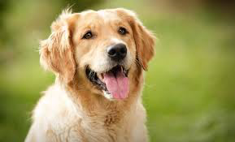
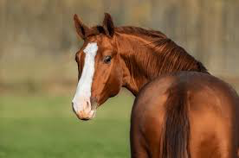
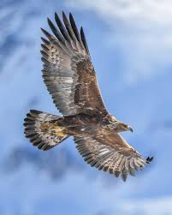
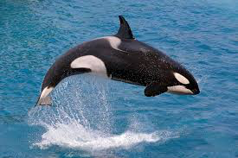
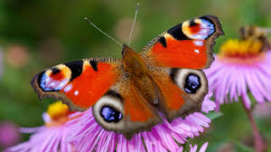
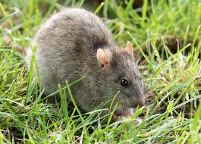
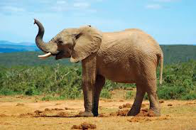
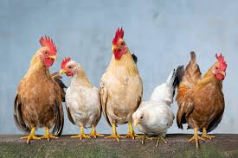

Slide 3
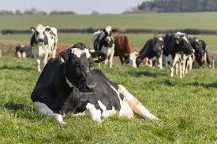
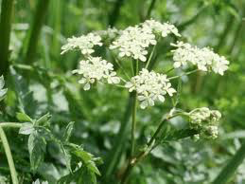
Cow
Cow (verb) To frighten someone into doing something, using threats or violence
Cow (noun) An offensive word for a woman who is considered to be unkind or unpleasant. Hence silly moo

Slide 4
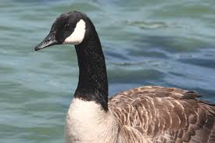
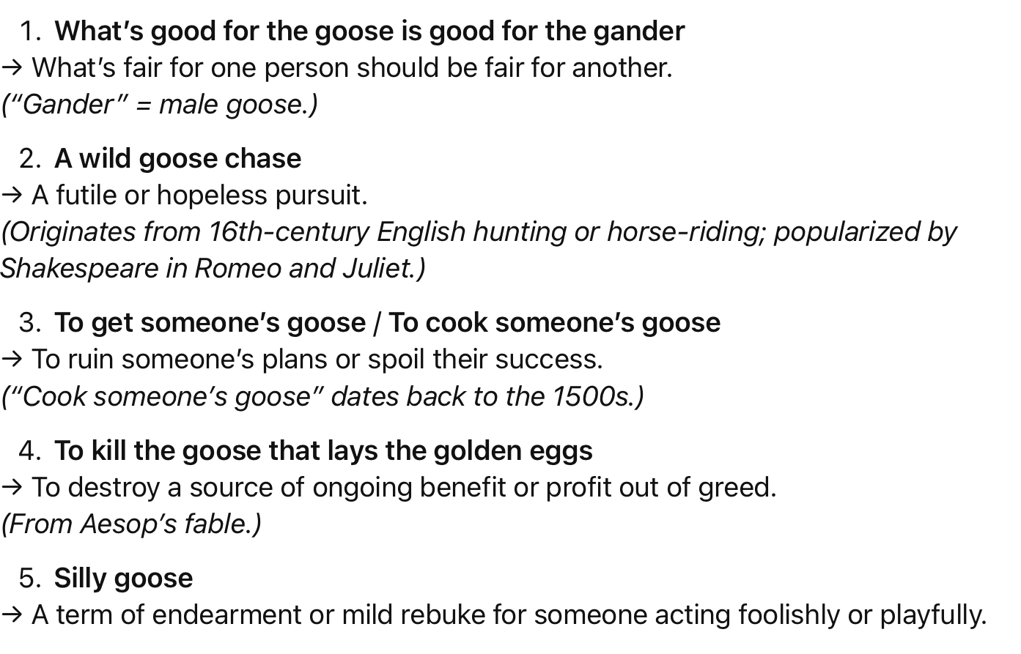
Goose

Slide 5
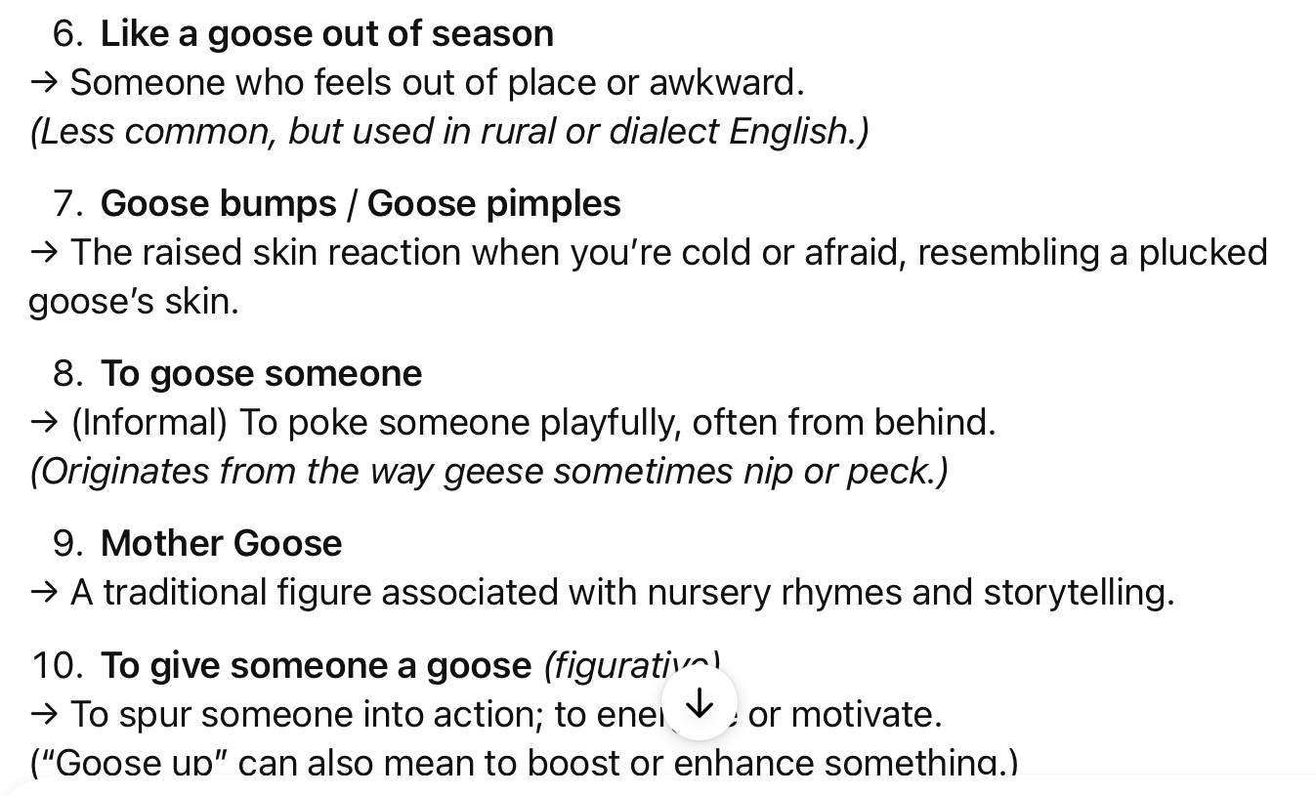
Goose

Slide 6

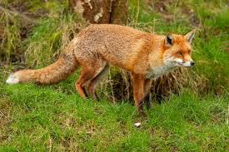
Fox
Chi va con la volpe, impara a rubare le galline.
If you choose a fox as your pal, you’ll learn to steal hens
Italian proverb: choose your friends carefully – if you pal up with a devious person, you’ll end up doing something bad.
Fox (verb) To confuse or deceive someone

Slide 7
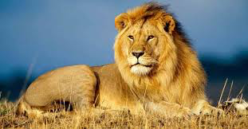
Lion
Meglio un giorno da leone che cento da pecora.
Better to be a lion for one day than a sheep for a hundred
Old Italian proverb dug up and paraded around during the fascist period. Better to have a short life of courage than a long life weakly following the flock.
Lionise (verb) To give (someone) a lot of public attention and approval

Slide 8
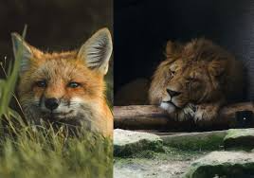
Fox and lion
Deve saper essere volpe per riconoscere i lacci, e leone per spaventare i lupi.
You need to be a fox to discover the snares and a lion to frighten off the wolves
Quotation from Machiavelli’s “The Prince”. If you want to govern efficiently you need to combine cleverness (know where the snares are) with brute force (scare off the wolves).

Slide 9
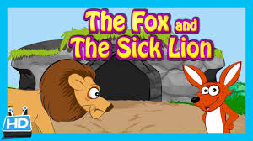
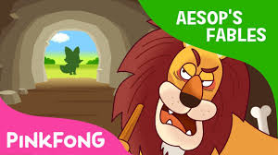
A lion has grown so old that it can no longer catch its prey. It comes up with the idea of using trickery, claiming to be sick, then catching animals that show sympathy and come to help, and putting them in a sack to eat later.
A fox does not fall for the lion’s trick, noticing that tracks lead into the lion’s den but not out again. Instead, it gets the lion to close its eyes, then steals the sack. The fox frees the animals that were caught in the sack, and advises them to be more careful in future.

Slide 10
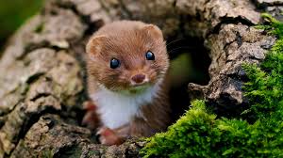
Weasel
It’s important to be able to distinguish between a stoat and a weasel: A weasel is weasily recognised whereas a stoat is stoatally different.
A more helpful mnemonic is that wee-sels are smaller than sizeable stoats.
The etymology of “weasel” comes via Old High German “wisula” but its origin is unknown.
The weasel is a member of the genus Mustela… the mustelids - this is the Latin word for weasel which combines mus (mouse) with telum (Javelin – for its long thin body)

Slide 11
Weasel
In the USA, it is a nickname for a native of South Carolina.
In Mexico it’s known as the kinkajou.
A weasel can refer to someone sneaky, conniving or untrustworthy
A “weasel-word” is a word that destroys or compromises the force of a statement, in the same way that a weasel ruins an egg by sucking out its contents: eg “some people say” or “it is thought” or “researchers believe”. The use of weasel words allows you to subsequently deny (“weasel out of”) any specific meaning.

Slide 12
Weasel
Shakespeare: (As You Like It) “I can suck melancholy out of a song as a weasel sucks eggs” (Act 2, scene 5).
W.C. Fields in the 1939 film “You can’t cheat an honest man” has the line: “Some weasel took the cork out of my lunch!”
Harold Pinter on being asked what his plays were about, said: “The weasel under the cocktail cabinet”.
J.K. Rowling gave Harry Potter’s sidekick the name of Ron Weasley.
Cockney rhyming slang: weasel is supposedly Cockney rhyming slang for “weasel and stoat”, ie coat. Thus to “pop the weasel” as in in the nursery rhyme means to pop (pawn) your coat.

Slide 13

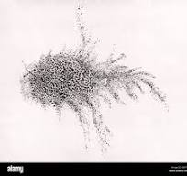
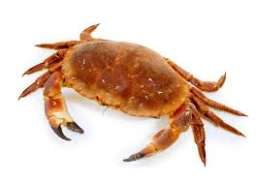
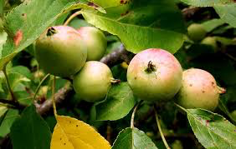
Crab
crabby (adj.) 1520s, …. "crooked, gnarled, rough," from extended sense of crab …. The meaning "disagreeable, sour, peevish" is attested from 1776...
https://www.etymonline.com/word/crabby
crabbit (Scottish) Grouchy, cantankerous

