Slide 1
u3a
12th June 2025
Pet hates
Liz Swinbank et al

Slide 2
Some of our pet hates
he played bad should of its had it’s day
between you and I your welcome
as such pre-order from … to …
reach out most well-known snuck
gotten passed away exponentially
them things like contribute

Slide 3
Pet hates
Grammar and punctuation
Pronunciation
Vocabulary and turns of phrase
new usage and Americanisms

Slide 4
Grammar
I don’t like them ones
How are we going to cope with all them people?
She should of known what to do
He played bad They done good
Blocks could be transported a lot easier
The most well-known example

Slide 5
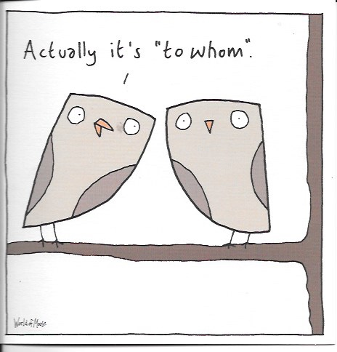
Grammar

Slide 6
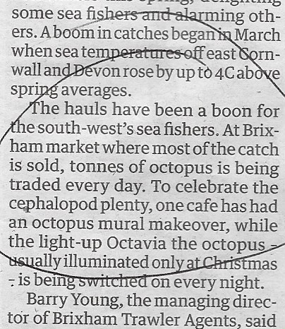
Grammar
ENGLAND ARE OUT OF THE WORLD CUP
THE CITY WALLS IS CURRENTLY CLOSED

Slide 7
Grammar - and punctuation
This was a present to my wife and I
Just between you and I
Goodbye from Ned and I
(Gardeners’ World, 29 May 2025)

Slide 8
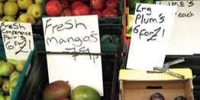
Apostrophe’s

Slide 9
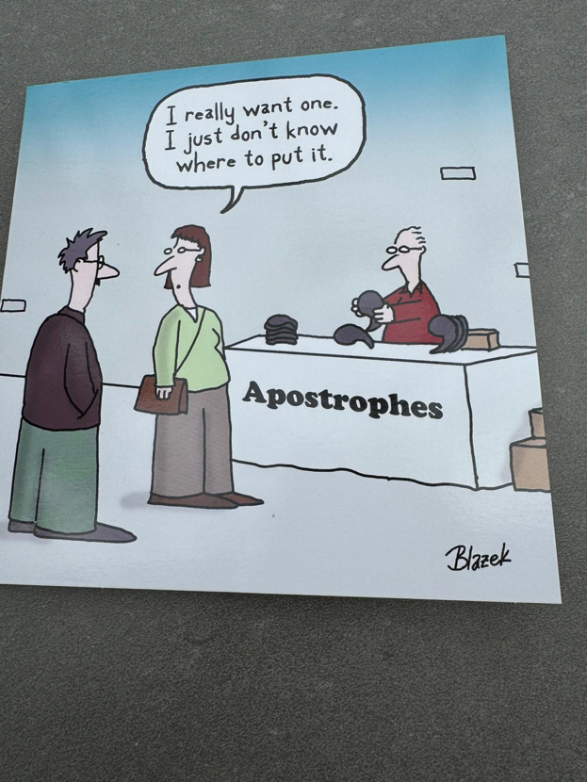
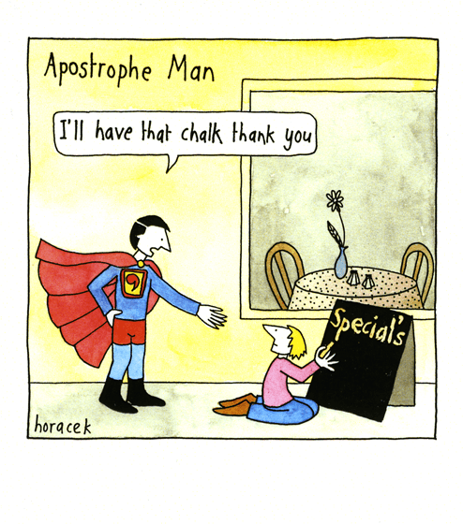
Apostrophes’

Slide 10
Apostrophes
DOG’S MUST BE KEPT ON A LEAD
CHUTNEY’S
MEN’S AND LADIES HAIRDRESSER

Slide 11
The Grammar Police
the grammar police got him
split his infinitive open
removed his colon
and left him lying commatose
the next day he was pronouned dead
full stop
Brian Bilston

Slide 12
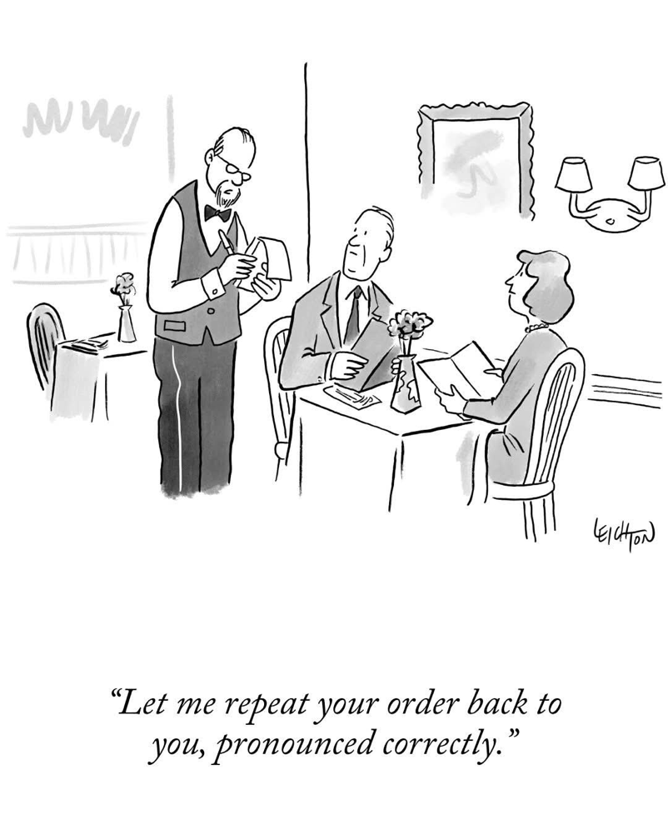
Pronunciation

Slide 13
Stress etc
mischievous etcetera
momentary secretary necessary
regulatory mandatory distribute
contribute integral pastoral
communal controversy kilometre

Slide 14
Stress
kilometre
centimetre kilowatt speedometer
millimetre kilocalorie thermometer
nanometre kilopascal barometer

Slide 15
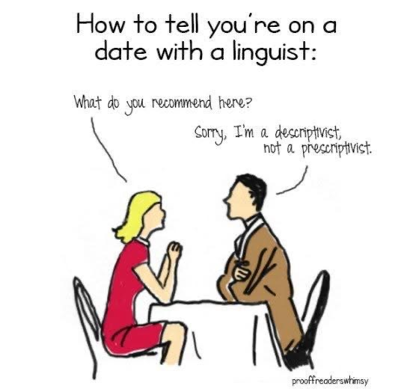

Slide 16
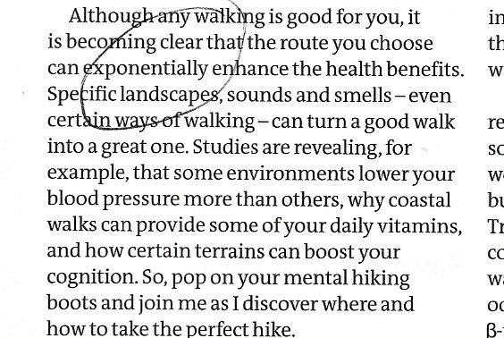
Vocabulary and turns of phrase
refute
exponentially
nice
coruscating
https://www.theguardian.com/commentisfree/2023/sep/10/misusing-words-can-change-their-dictionary-definitions-coruscating

Slide 17
Vocabulary and turns of phrase
pre-order pre-heat pre-book
under/over-estimate
as such
like
from … to …

Slide 18
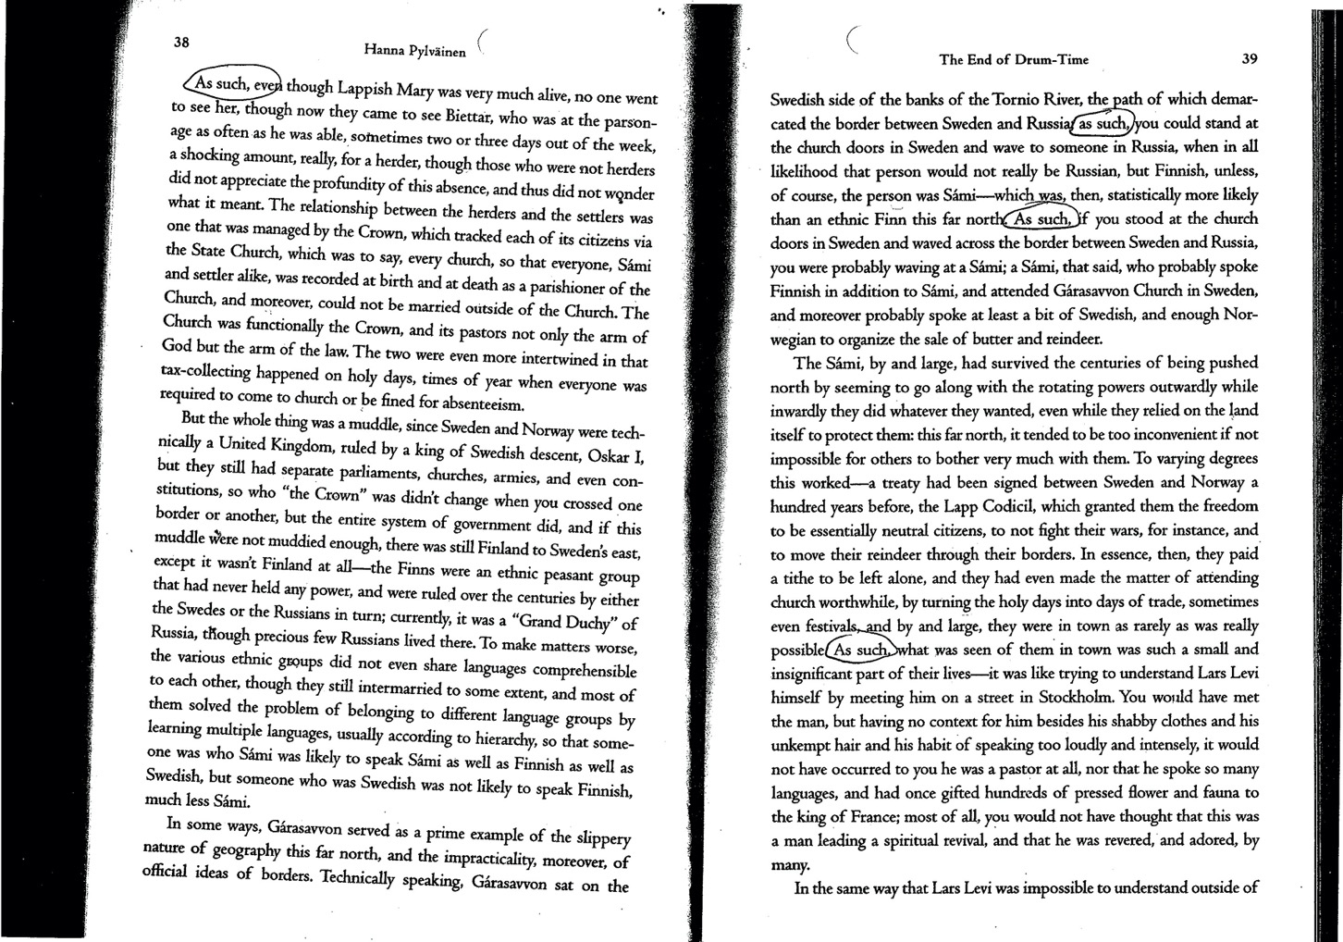

Slide 19
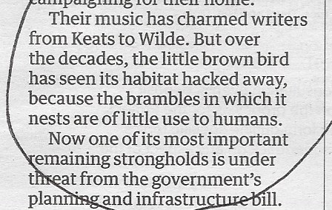
Vocabulary and turns of phrase

Slide 20
Vocabulary and turns of phrase
snuck tween
stand in line reach out
mental health going forward
passed away loved ones
bathroom a hundred percent
faucet gotten

Slide 21
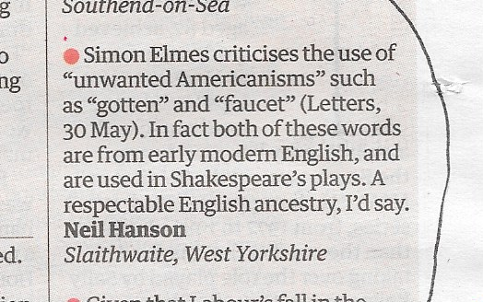
Americanisms
gotten faucet

Slide 22
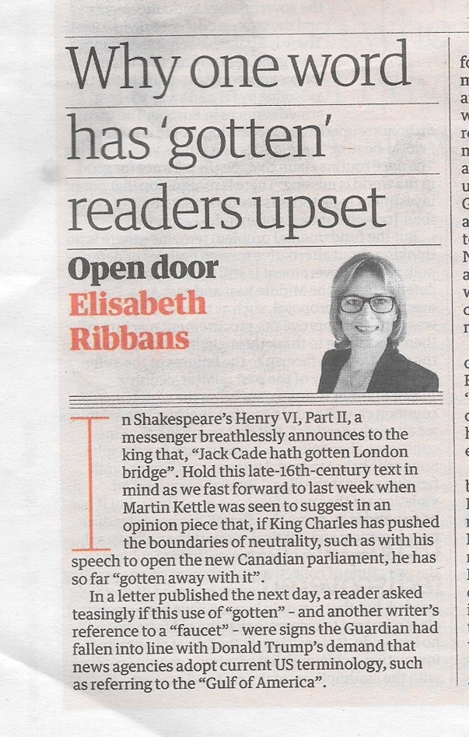
Americanisms
gotten faucet
https://www.theguardian.com/commentisfree/2025/jun/04/use-word-gotten-some-readers-upset

Slide 23
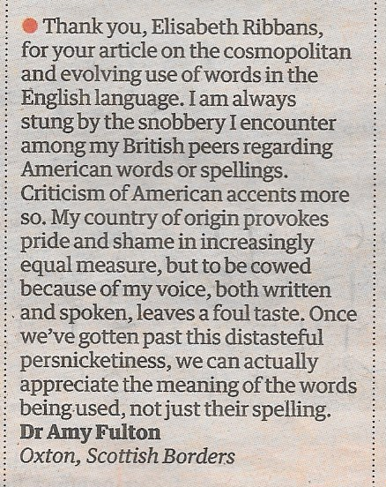
Americanisms

Slide 24
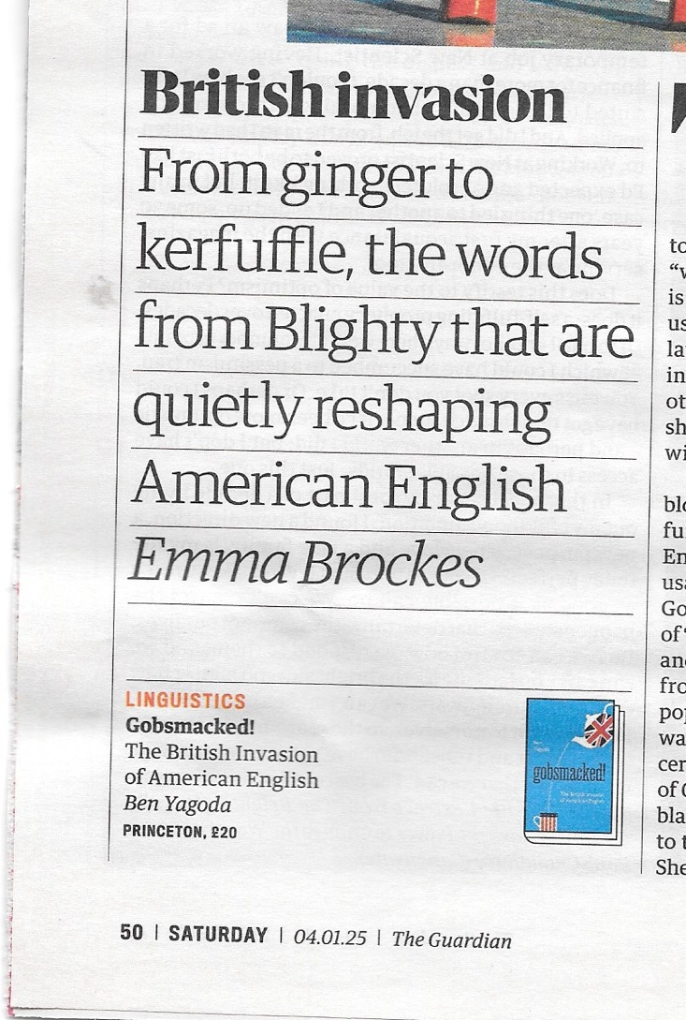
Americanisms

Slide 25
Pedant’s
Foot soldiers in the War on Error
They’re here to save us from ourselves,
With Fowler’s Modern English Usage
(first edition, nineteen twelve).
They scrutinise each word we write
For typos, gaffes, et cetera,
Correcting all the dumb mistakes
To make our grammar betterer.
They sigh and tut and tell us off
For the rules we have forsaken
And chart this nation’s steep decline
By the care we should of taken.

Slide 26
Custodians of the King’s English,
They merely serve to keep it pure
And restrict, they hope, the ignorant
To three mistakes or less.
And in doing so they hold no fear
they will deprive a thing of life:
for it’s not important what is said,
What matters is that its right
Brian Bilton
https://x.com/brian_bilston/status/1782314692733485427?lang=en-GB

Slide 27
Pedants
Foot soldiers in the War on Error
they’re here to save us from ourselves,
with Fowler’s Modern English Usage
(first edition, 1912).
For these Crusaders of Correctness,
beloved Guardians of Grammar,
hunt down blunders big and small
upon which to wield their hammer.
They hold no fears that in so doing
they will deprive the thing of life:
for it does not matter what it says,
what’s important is that it’s right.

Slide 28
But that, in turn, got drummed into them
by fusty teachers in dusty schools
ie mistakes are unforgiveable
and you should always follow the rules.
So, although being challenged by pedants
sometimes feels like a kind of assault
I do what I can to stay pleasant
because perhaps it isn’t their fault.
Brian Bilston
https://x.com/brian_bilston/status/714869171234938883

