Slide 1
u3a
11 July 2024
End-of-year miscellany
Liz Swinbank et al

Slide 2
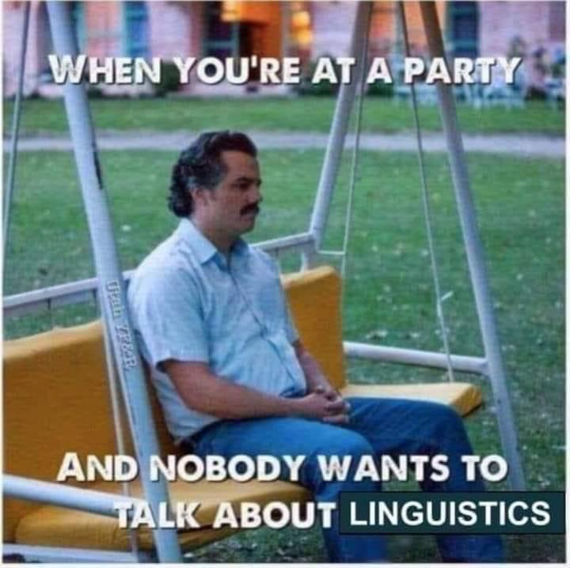

Slide 3
Miscellany
Posh language
Apostrophes
What’s that word?
Vowels
English spelling
Loveliest languages
Tongue twisters

Slide 4
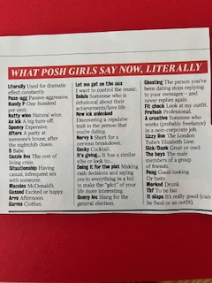

Slide 5
What posh girls say now, literally
Literally used for dramatic effect
Pass-agg passive-aggressive
Hundy P one hundred percent
Natty wine natural wine
As ick a big turn-off
Spenny expensive
Afters a party at someone’s house after the nightclub closes
Cozzie livs the cost of living
Situationship having casual, infrequent, sex with someone
Maccies McDonald’s

Slide 6
What posh girls say now, literally
Gassed excited or happy
Arvo afternoon
Garms clothes
Let me get on the aux I want to control the music
Delule someone who is delusional about their achievements/love life
New ick unlocked discovering repulsive trait in person you are dating
Nervy B nervous breakdown
Cocky cocktail
It’s giving… it is similar to …
Doing it for the plot making a rash decision

Slide 7
What posh girls say now, literally
Genny lec general election
Ghosting stop replying to messages
Fit check look at my outfit
Profesh professional
A creative worker in non-corporate job
Lizzy line London underground’s Elizabeth line
Sick/dark great or cool
Peng good looking
Merked drunk
It slaps it’s really good (food or outfit)

Slide 8
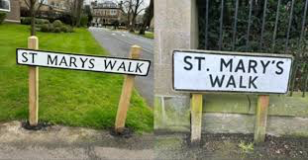
Apostrophes
“This week there were reports that residents of North Yorkshire were irked that their road signs were having punctuation removed to make it easier for computer databases. We’ll just park for one moment how bad your computer database must be in 2024 if it cannot cope with apostrophes. But it did prompt a question: are you better with apostrophes than a North Yorkshire computer database? Find out with our fun but pedantically accurate quiz.”
The Guardian 7 May 2024
https://www.theguardian.com/uk-news/article/2024/may/07/apostrophes-possession-contractions-plurals-quiz

Slide 9
Apostrophe quiz
1. Which of these has the correct apostrophe?
A Kenneth William's did the voices for a cartoon named after Will-o-the-wisp
B Kenneth Williams did the voice's for a cartoon named after Will-o-the-wisp
C Kenneth Williams did the voices for a cartoon named after Will-o'-the-wisp
2. How many sisters and how many friends are being referred to in this phrase: my sisters’ friend’s books.
A It refers to one sister and her friend
B It refers to one sister with lots of friends
C It refers to more than one sister, and their friend
D It refers to more than one sister, and their friends

Slide 10
3. If you were to walk from the tip of England to the tip of Scotland, traditionally your route would go from …
A Lands End to John o'Groats
B Land's End to John o'Groats
C Lands' End to John o'Groats
4. If some children own some bicycles that get involved in an accident, where does the apostrophe go?
A Boris shouted angrily as he crashed his big red bus into the children's bicycles
B Boris shouted angrily as he crashed his big red bus into the childrens' bicycles
C Boris shouted angrily as he crashed his big red bus into the childrens bicycle's

Slide 11
5. What is the full name of the Premier League team know aa Wolves?
A Wolverhampton Wanderers Football Club
B Wolverhampton Wanderer's Football Club
C Wolverhampton Wanderers' Football Club
Scilly Isles. Which one of these has an errant apostrophe?
A St Mary’s C St Martin’s
B St Agne’s D St Helen’s
7. Which of these sentences has the correct apostrophe placement?
A Suella Braverman didn't even get one week's notice when she was sacked as home secretary
B Suella Braverman didn't even get one weeks notice when she was sacked as home secretary

Slide 12
8. Which of these means the dinners belonging to the geese?
A The geeses' dinners C The geese's dinners
B The geese's dinner’s D The geeses' dinners’
9. What is the name on the signs of the main thoroughfare in Edinburgh?
A Princes Street
B Prince's Street
C Princes' Street
10. Only one of these is right …
A The very naughty miniature dachshund licked its paws
B The very naughty miniature dachshund licked it's paws

Slide 13
11. When you spell its without an apostrophe, why do you spell its without an apostrophe
A Because it is a contraction
B Because it is a plural
C Because it is a possessive pronoun
12. Where do you correctly put the punctuation in this sentence?
A My mortgage payment's went up spectacularly thanks to Liz Truss' 49 days in power
B My mortgage payments went up spectacularly thanks to Liz Truss's 49 day's in power
C My mortgage payments went up spectacularly thanks to Liz Truss's 49 days in power

Slide 14
13. How do you punctuate this Oxford college?
A All Souls College B All Soul's College C All Souls' College
14. This nautical term shows off with the most apostrophes in the English language, but which of these is correct?
A Fo'c's’le B Fo'cs'l’e C F'oc's'le
15. The very first ASCII (American Standard Code for Information Interchange) standard used by computers did include the apostrophe. When was it first published?
A 1943 C 1963
B 1953 D 1973

Slide 15
What’s that word?
Obtundity
Rugosity
Refection
Synoptic
Endogamous
Feuing
Vug
Myse

Slide 16
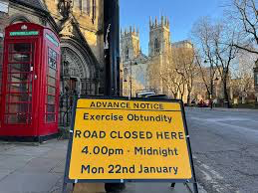
Obtundity
York January 2024
An operation to test the response
of emergency services to terrorist
attack
Dictionary definitions
Obtundity: the state or characteristic of having dulled senses or limited awareness
To obtund: to close (a hole or cavity) so as to prevent the flow of gas through it

Slide 17
What’s that word?
Obtundity
Rugosity roughness of a surface
Refection a light meal
Synoptic giving a general view of the whole
Endogamous marrying only within the local community/tribe/clan
Feuing a Scottish system of land tenure
Vug
Myse

Slide 18
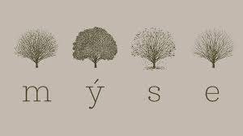
Vug
A small cavity within a rock. Most commonly, cracks and fissures are partially filled with quartz, calcite or other secondary minerals
Myse
Restaurant in Hovingham
“Named after the Anglo-Saxon word for ‘eating at the table’, ‘Time and Place’ shape the menus, with the ingredients and flavours unique to our location and available to us on each individual day dictating the produce-driven style of cooking. “
Wiktionary
To cut up or slice food into small pieces

Slide 19
Words
Emma
Drinks coffee, not tea; beer and Guinness, not wine, spirits, ale or stout
Eats beef and gammon, not pork, lamb, chicken or ham; carrots and cabbage, not peas or potatoes; cheese and butter, not jam
Reads books, not magazines
Favourite colours are green and yellow.
Wears dresses, dungarees and tee-shirts.
Ann-Louise
Works in education, with a focus on pupil behaviour
Has a reputation for being somewhat facetious and can be given to speculation
Favourite vegetable is cauliflower. Plays the tambourine
Her garden has a fine collection of sequoias and euphorbias
Wants to know more about the chemical elements praseodymium and seaborgium

Slide 20
A word hunt
An English word in which ‘hh’ appears withhold
An English word ending in ‘mt’ dreamt
An English word in which all the vowels a, e, i, o, u, appear in alphabetical order facetious abstemious
An English word of two or more syllables that contains only ‘a’ and no other vowels – and similarly for e, i, o, u, y
catamaran taramasalata
represented insipidity schoolroom uncut
rhythm shyly syzygy

Slide 21
Vowels: why y?
The letter ‘y’ can represent a consonant
you yes mayonnaise
or a vowel, either on its own
shy thyme funny rhythm
or combined with another vowel
play joy buy grey dye

Slide 22
English spelling
Our language is illogical, complex and inconsistent. Tim Smith-Laing considers whether we should overhaul the system and write phonetically instead
Here’s a challenge for you: read the following paragraph aloud.
Fork the potatoes and work the tomatoes? Hoe the rows now, then mow, and wait to weigh the hay? Plough the rough right through? With this cough, though? The very thought. No – you know that after school I’m scheduled to shear the ewes, prune the yews, and bear beers for the four bare beardless bears here, before tearing in tears to hear a reading in Reading about seeding and shedding. Fun for two, perhaps – none for one alone, on my own.
The Telegraph July 2024
http://digitaleditions.telegraph.co.uk/data/1756/reader/reader.html?social#!preferred/0/package/1756/pub/1756/page/71/article/NaN

Slide 23
Research study
What is the world’s loveliest language?
"In one example, a team of scholars looked into whether some languages are seen as more beautiful than others (by ordinary folk, not experts). The researchers played identical scenes from a film, in dozens of different languages, to a big group of volunteers from around the world. The surprising result was that nearly all languages were rated close to each other in the middle of a scale of attractiveness. Nor could the researchers find any particular features—the presence or absence of certain sounds, say—that predicted which languages would be rated as (slightly) prettier. The strongest result was that people prefer familiar languages, and female voices."
The Economist 11 January 2024

Slide 24
Research study
Tongue-twisters could be used to gauge alcohol-intoxication levels, study finds
Whether it is the story of Peter Piper and his pickled peppers or a woman selling seashells on the seashore, tongue-twisters tackled when sober can sound rather different after a drink.
Now researchers believe such changes, in particular those relating to pitch and frequency, could be used to alert people to their level of intoxication.
The Guardian 9 Nov 2023
https://www.theguardian.com/society/2023/nov/09/tongue-twisters-used-gauge-alcohol-intoxication-levels-study

Slide 25
Tongue twisters
Dr Brian Suffoletto, the first author of a study from Stanford University, said the approach has a number of potential future applications.
“The most obvious one is as a form of ignition lock on cars which would not allow someone to start their car unless they could pass the ‘voice challenge’ which could be used in certain high-risk workplaces like school bus driver or heavy machine operator to ensure public safety.
“Another application could be in restaurants or bars so a bartender can know when to cut someone off.”
Writing in the Journal of Studies on Alcohol and Drugs, Suffoletto and colleagues report how 18 adults aged 21 and over were initially recorded reciting a tongue-twister.
Each participant was then given a large, weight-based dose of alcohol – enough to intoxicate them – and subsequently asked to recite a different tongue-twister each hour, up to seven hours after consuming the alcohol. This speech was recorded.

Slide 26
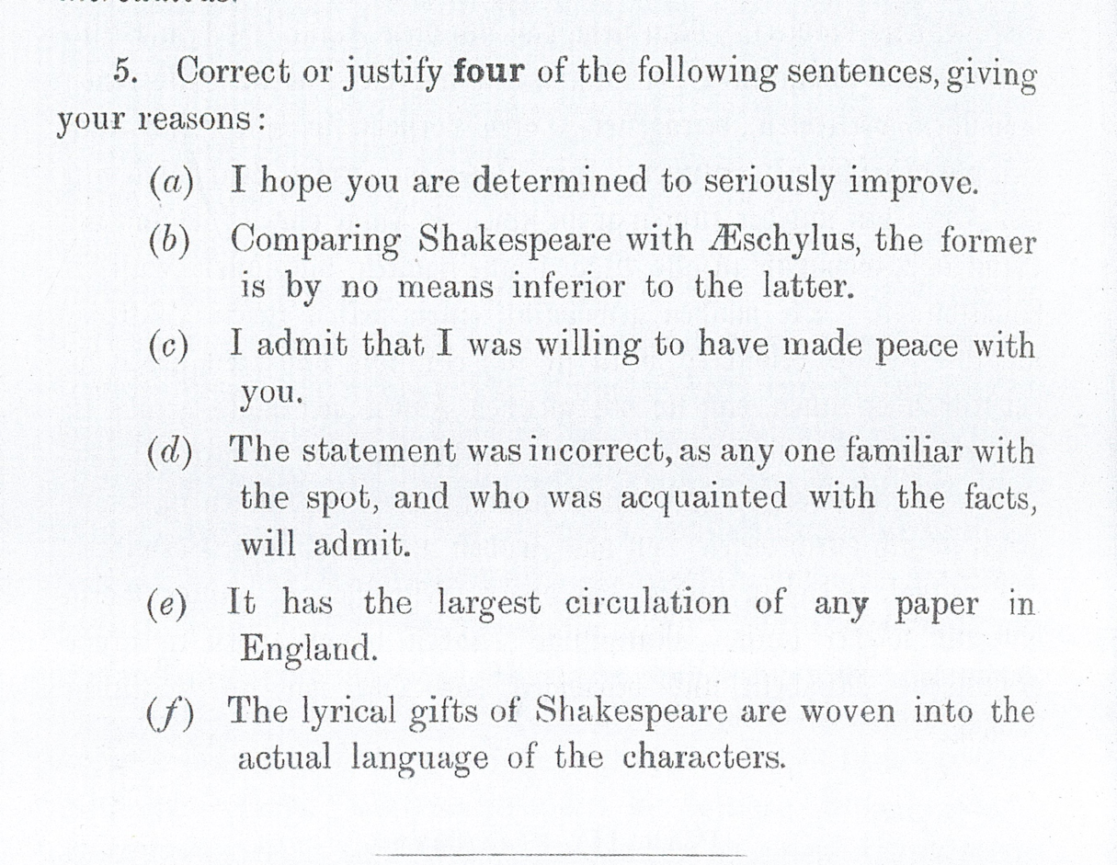
From an exam paper (??)

Slide 27
