Slide 1
u3a
8th May 2025
War writing
Liz Swinbank et al

Slide 2
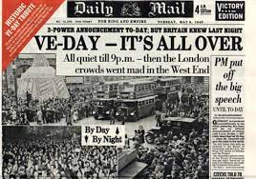

Slide 3
War writing
From the Bible onwards
WW2
reports, speeches, poems, anthologies …
VE Day 80 years on

Slide 4
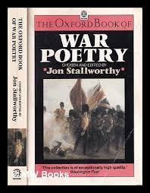

Slide 5
Exodus 15 vv 1-10
Then sang Moses and the children of Israel this song unto the Lord, and spake, saying, I will sing unto the Lord, for he hath triumphed gloriously: the horse and his rider hath he thrown into the sea. The Lord is my strength and song, and he is become my salvation: he is my God, and I will prepare him an habitation; my father's God, and I will exalt him. The Lord is a man of war: the Lord is his name. Pharaoh's chariots and his host hath he cast into the sea: his chosen captains also are drowned in the Red sea. The depths have covered them: they sank into the bottom as a stone. Thy right hand, O Lord, is become glorious in power: thy right hand, O Lord, hath dashed in pieces the enemy. And in the greatness of thine excellency thou hast overthrown them that rose up against thee: thou sentest forth thy wrath, which consumed them as stubble. And with the blast of thy nostrils the waters were gathered together, the floods stood upright as an heap, and the depths were congealed in the heart of the sea. The enemy said, I will pursue, I will overtake, I will divide the spoil; my lust shall be satisfied upon them; I will draw my sword, my hand shall destroy them. Thou didst blow with thy wind, the sea covered them: they sank as lead in the mighty waters.

Slide 6
2 Samuel 1 vv 19-27
The beauty of Israel is slain upon thy high places: how are the mighty fallen! Tell it not in Gath, publish it not in the streets of Askelon; lest the daughters of the Philistines rejoice, lest the daughters of the uncircumcised triumph. Ye mountains of Gilboa, let there be no dew, neither let there be rain, upon you, nor fields of offerings: for there the shield of the mighty is vilely cast away, the shield of Saul, as though he had not been anointed with oil. From the blood of the slain, from the fat of the mighty, the bow of Jonathan turned not back, and the sword of Saul returned not empty. Saul and Jonathan were lovely and pleasant in their lives, and in their death they were not divided: they were swifter than eagles, they were stronger than lions. Ye daughters of Israel, weep over Saul, who clothed you in scarlet, with other delights, who put on ornaments of gold upon your apparel. How are the mighty fallen in the midst of the battle! O Jonathan, thou was slain in thine high places. I am distressed for thee, my brother Jonathan: very pleasant hast thou been unto me: thy love to me was wonderful, passing the love of women. How are the mighty fallen, and the weapons of war perished!

Slide 7
The Charge of the Light Brigade
Half a league, half a league,
Half a league onward,
All in the valley of Death
Rode the six hundred.
“Forward, the Light Brigade!
Charge for the guns!” he said.
Into the valley of Death
Rode the six hundred.
“Forward, the Light Brigade!”
Was there a man dismayed?
Not though the soldier knew
Someone had blundered.
Theirs not to make reply,
Theirs not to reason why,
Theirs but to do and die.
Into the valley of Death
Rode the six hundred.

Slide 8
Cannon to right of them,
Cannon to left of them,
Cannon in front of them
Volleyed and thundered;
Stormed at with shot and shell,
Boldly they rode and well,
Into the jaws of Death,
Into the mouth of hell
Rode the six hundred.
Flashed all their sabres bare,
Flashed as they turned in air
Sabring the gunners there,
Charging an army, while
All the world wondered.
Plunged in the battery-smoke
Right through the line they broke;
Cossack and Russian
Reeled from the sabre stroke
Shattered and sundered.
Then they rode back, but not
Not the six hundred.

Slide 9
Cannon to right of them,
Cannon to left of them,
Cannon behind them
Volleyed and thundered;
Stormed at with shot and shell,
While horse and hero fell.
They that had fought so well
Came through the jaws of Death,
Back from the mouth of hell,
All that was left of them,
Left of six hundred.
Crimean War 1854
Alfred, Lord Tennyson 1809 - 1892
When can their glory fade?
O the wild charge they made!
All the world wondered.
Honour the charge they made!
Honour the Light Brigade,
Noble six hundred!

Slide 10
Dulce et Decorum Est
Bent double, like old beggars under sacks,
Knock-kneed, coughing like hags, we cursed through sludge,
Till on the haunting flares we turned our backs,
And towards our distant rest began to trudge.
Men marched asleep. Many had lost their boots,
But limped on, blood-shod. All went lame; all blind;
Drunk with fatigue; deaf even to the hoots
Of gas-shells dropping softly behind.

Slide 11
Gas! GAS! Quick, boys!—An ecstasy of fumbling
Fitting the clumsy helmets just in time,
But someone still was yelling out and stumbling
And flound’ring like a man in fire or lime.—
Dim through the misty panes and thick green light,
As under a green sea, I saw him drowning.
In all my dreams before my helpless sight,
He plunges at me, guttering, choking, drowning.

Slide 12
If in some smothering dreams, you too could pace
Behind the wagon that we flung him in,
And watch the white eyes writhing in his face,
His hanging face, like a devil’s sick of sin;
If you could hear, at every jolt, the blood
Come gargling from the froth-corrupted lungs,
Obscene as cancer, bitter as the cud
Of vile, incurable sores on innocent tongues,—
My friend, you would not tell with such high zest
To children ardent for some desperate glory,
The old Lie: Dulce et decorum est
Pro patria mori.
Wilfred Owen 1893-1918

Slide 13
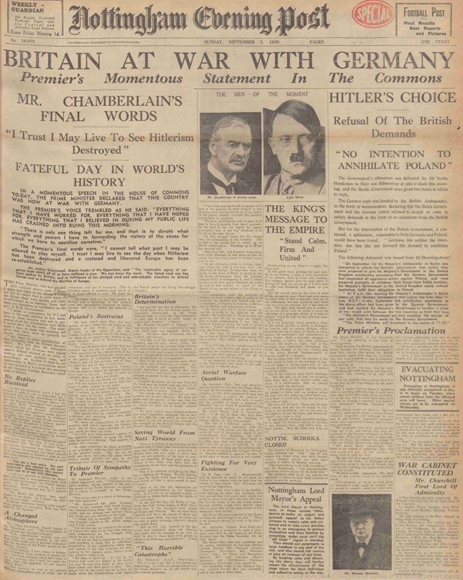

Slide 14
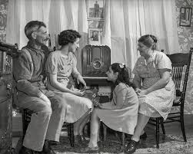

Slide 16
To a conscript of 1940
A soldier passed me in the freshly fallen snow, His footsteps muffled, his face unearthly grey: And my heart gave a sudden leap As I gazed on a ghost of five-and-twenty years ago. I shouted Halt! and my voice had the old accustom'd ring And he obeyed it as it was obeyed In the shrouded days when I too was one
Of an army of young men marching Into the unknown. He turned towards me and I said: `I am one of those who went before you Five-and-twenty years ago: one of the many who never returned, Of the many who returned and yet were dead.

Slide 17
We went where you are going, into the rain and the mud: We fought as you will fight With death and darkness and despair; We gave what you will give -- our brains and our blood. We think we gave in vain. The world was not renewed. There was hope in the homestead and anger in the streets, But the old world was restored and we returned To the dreary field and workshop, and the immemorial feud Of rich and poor. Our victory was our defeat. Power was retained where power had been misused And youth was left to sweep away The ashes that the fires had strewn beneath our feet.

Slide 18
But one thing we learned: there is no glory in the dead Until the soldier wears a badge of tarnish'd braid; There are heroes who have heard the rally and have seen The glitter of garland round their head. Theirs is the hollow victory. They are deceived. But you my brother and my ghost, if you can go Knowing that there is no reward, no certain use In all your sacrifice, then honour is reprieved. To fight without hope is to fight with grace, The self reconstructed, the false heart repaired.' Then I turned with a smile, and he answered my salute As he stood against the fretted hedge, which was like white lace.
Herbert Read 1893 - 1968

Slide 19
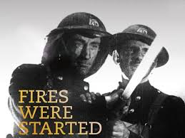
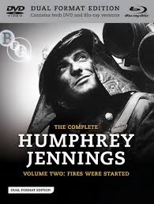
A Wartime Documentary, 1943
https://www.youtube.com/watch?v=gaqvpwBCbkQ

Slide 20
The Evacuee
She woke up under a loose quilt
Of leaf patterns, woven by light
At the small window, busy with the boughs
Of a young cherry; but wearily she lay,
Waiting for the siren, slow to trust
Nature’s deceptive peace, and then afraid
Of the long silence, she would have crept
Uneasily from the bedroom with its frieze
Of fresh sunlight, had not a cock crowed,
Shattering the surface of that limpid pool
Of stillness, and before the ripples died
One by one in the field’s shallows,
The farm woke with uninhibited din.

Slide 21
And now the noise and not the silence drew her
Down the bare stairs at great speed.
The sounds and voices were a rough sheet
Waiting to catch her, as though she leaped
From a scorched storey of the charred past.
And there the table and the gallery
Of farm faces trying to be kind
Beckoned her nearer, and she sat down
Under an awning of salt hams.

Slide 22
And so she grew, a small bird in the nest
Of welcome that was built about her,
Home now after so long away
In the flowerless streets of the drab town.
The men watched her busy with the hens,
The soft flesh ripening warm as corn
On the sticks of limbs, the grey eyes clear,
Rinsed with dew of their long dread.
The men watched her, and, nodding, smiled
With earth’s charity, patient and strong.
RS Thomas 1913 - 2000

Slide 23
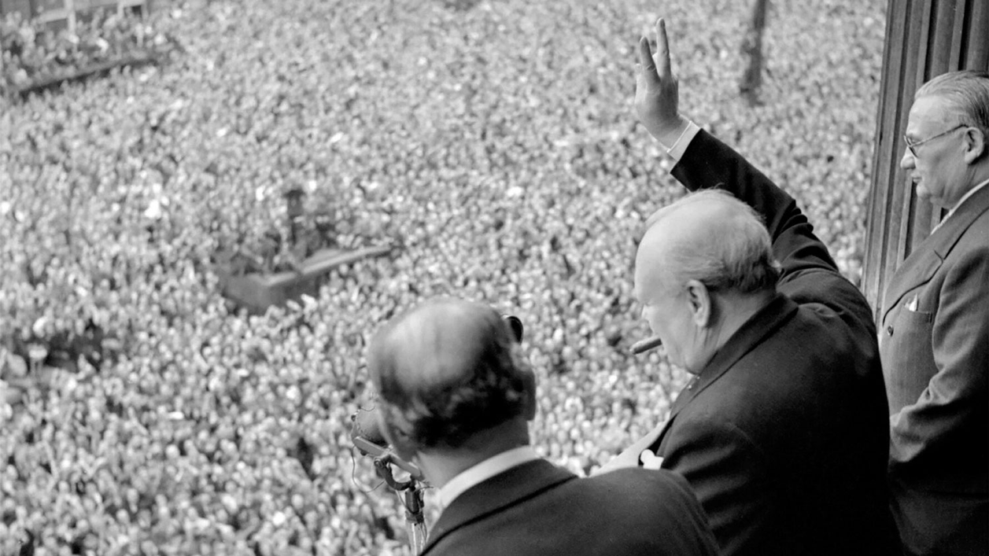
Winston Churchill Whitehall 8 May 1945

Slide 24
My dear friends, this is your hour. This is not victory of a party or of any class. It’s a victory of the great British nation as a whole.
We were the first, in this ancient island, to draw the sword against tyranny. After a while we were left all alone against the most tremendous military power that has been seen. We were all alone for a whole year.
There we stood, alone. Did anyone want to give in? Were we down-hearted?
The lights went out and the bombs came down. But every man, woman and child in the country had no thought of quitting the struggle. London can take it. So we came back after long months from the jaws of death, out of the mouth of hell, while all the world wondered.
When shall the reputation and faith of this generation of English men and women fail?
I say that in the long years to come not only will the people of this island but of the world, wherever the bird of freedom chirps in human hearts, look back to what we’ve done and they will say “do not despair, do not yield to violence and tyranny, march straightforward and die if need be - unconquered.”
Now we have emerged from one deadly struggle - a terrible foe has been cast on the ground and awaits our judgment and our mercy.

Slide 25
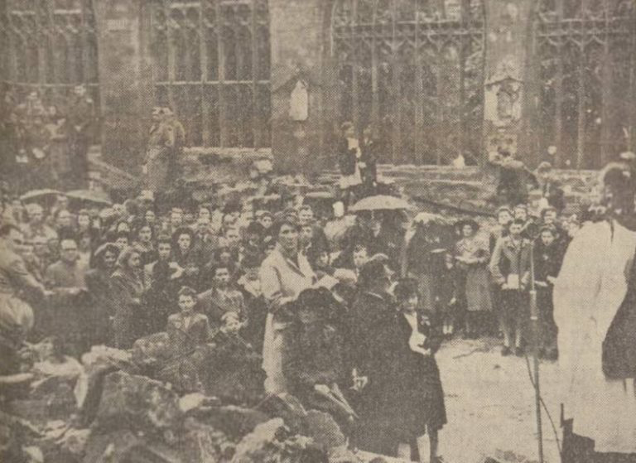
8th May 1945 VE Day in Coventry

Slide 26
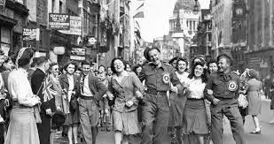

Slide 27
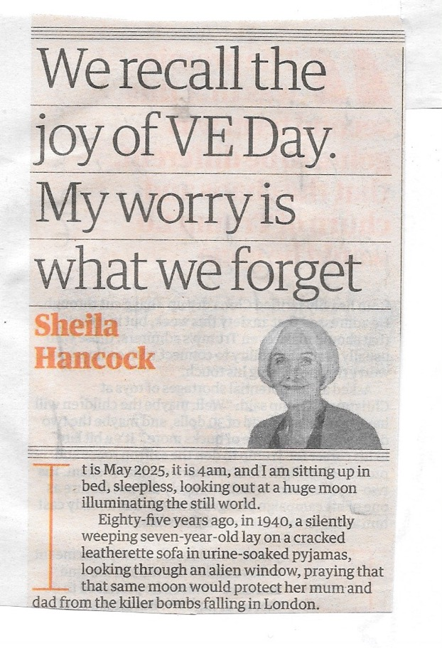
Sheila Hancock
The Guardian
3 May 2025
https://www.theguardian.com/commentisfree/2025/may/03/ve-day-second-world-war-sheila-hancock

Slide 28
It is May 2025, it is 4am, and I am sitting up in bed, sleepless, looking out at a huge moon illuminating the still world.
Eighty-five years ago, in 1940, a silently weeping seven-year-old lay on a cracked leatherette sofa in urine-soaked pyjamas, looking through an alien window, praying that that same moon would protect my mum and dad from the killer bombs falling in London.
That morning, my dad had tied a label to my gas mask strap with my name and address written on it, and waved me off from the platform barrier after making me recite, yet again, my identity number in case I became detached from my group of evacuees. It was CJFQ 29:4; my old brain has forgotten many things, but that number is deeply engrained. The details of what happened next are confused, until the door at the bottom of the stairs in my billet was slammed closed by my unwilling hosts, and I lay trembling on that settee. As an adult, my first reaction to everything is fear, which I put down to my wartime childhood, along with my ability to survive. After two runaway escapades I was allowed to return to London, preferring bombs to bullying locals.

Slide 29
…
Because I now deeply fear the dangerous signs of history repeating itself, I want everyone to remember that war is terrible. On VE Day 1945, the world was looking at the complete destruction of many cities, some by us. Tens of millions of people were dead or homeless. It was hard to wholeheartedly rejoice in May 1945.
Sorry to be a spoilsport. I actually hope everyone comes together and has a lovely time on the 80th anniversary. I think I probably quite enjoyed myself in 1945. The kids had a street party tea, with junket and blancmange (whatever happened to them?), with evaporated milk as cream, and a few chocolates. A feast in those strictly rationed days.

Slide 30
Now, our beautiful planet is under threat in many ways. History shows that the solution is definitely not to be found in autocratic leadership. Let us aim to unite the available worldwide wisdom to tackle the global crises together. Time is running out.
This week, the moon reminded me of a wartime child who, along with her contemporaries, will soon be gone, taking our painful memories with us. I look back with some pride at the way that generation of adults survived, drained but determined to make the world a better place. And they did.
Please God, don’t let us betray them. We must not forget and we must never let it happen again.

