Slide 1
u3a
13 March 2025
I hear what you say
Liz Swinbank et al

Slide 2
I hear what you say
Sounds that are most readily misheard
Misheard or misinterpreted?
There’s a word for that …
Songs, hymns etc
Visual cues
Other languages
Software

Slide 3
I hear what you say
Send three and fourpence, we’re going to a dance
Black eyes
A bowl in a china shop
In our days
To all intensive purposes
Free reign
On tenderhooks

Slide 4
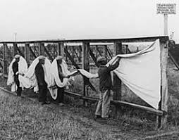
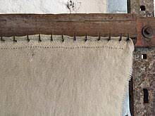
On Tenterhooks

Slide 5
On Tender Hooks
Let me cut to the cheese: every time you open your mouth, I’m on tender hooks.
You charge at the English language like a bowl in a china shop. Please nip it in the butt.
On the spurt of the moment, the phrases tumble out. It’s time you gave up the goat.

Slide 6
Curve your enthusiasm. Don’t give them free range. The chickens will come home to roast.
Now you are in high dungeon. You think me a damp squid: on your phrases I shouldn’t impose.
But they spread like wildflowers in a doggy-dog world, and your spear of influence grows.
Brian Bilston April 2018

Slide 7
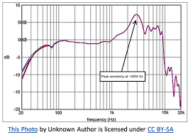
Consonants
Consonants are much more readily misheard and confused than vowels.
p, b t, d k, g f, v, th
Plosive and fricative consonants are particularly prone to being misheard.
They involves high-frequency
sound waves to which our
ears are less sensitive.

Slide 8
Consonants
Plosive p, b t, d k, g
Obstruction of airflow builds up pressure in the mouth, followed by sudden release through the mouth
Nasal n, m, ng
Obstruction of airflow in the mouth but air is allowed to escape through the nose
Fricative f, v th, th s, z sh, zh h
Air forced through a narrow gap between two articulators (eg tongue and palate) that creates friction

Slide 9
Consonants
Affricates ch, j
Begin with complete obstruction, then air is released as the tongue moves backwards through the mouth
Approximants w r, l y
Produced without complete or near closure, with two articulators moderating the air flow
https://www.sltinfo.com/consonants

Slide 10
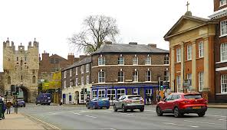
Consonants
Ploughswaingate
Ploxhamgate
Blossom Gate

Slide 11
Eggcorn …
An eggcorn is the alteration of a word or phrase through the mishearing or reinterpretation of one or more of its elements, creating a new phrase which is plausible when used in the same context. Thus, an eggcorn is an unexpectedly fitting or creative malapropism.
The term egg corn (later contracted into one word, eggcorn) was coined by professor of linguistics Geoffrey Pullum in September 2003 in response to an article by Mark Liberman... Liberman discussed the case of a woman who had used the phrase egg corn for acorn, and he noted that this specific type of substitution lacked a name. Pullum suggested using egg corn itself as a label.
https://en.wikipedia.org/wiki/Eggcorn

Slide 12
Eggcorn, oronym …
There is a word to describe this grammatical phenomenon. Oronyms are sequences of words or even complete phrases that sound similar to each other, and our brain employs them often
https://www.audicus.com/best-misheard-sentences/

Slide 13
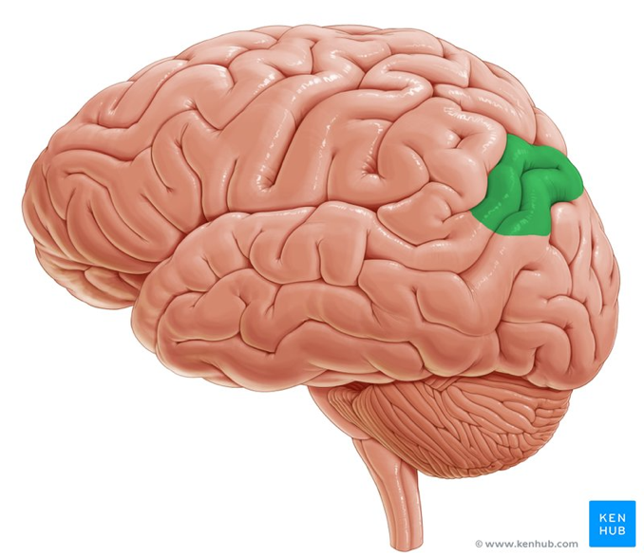
Eggcorn, oronym …
The region of the brain called the angular gyrus uses all previous knowledge to fill in gaps with predictable words. If you are missing whole phrases or even just the last syllable of a word, it is this section of the brain that completes the sentence for you without you consciously having to employ this method.

Slide 14
Eggcorn, oronym, mondegreen …
Sylvia Wright in Harper's Magazine 1954
When I was a child... one of my favorite poems began, as I remember:
Ye Highlands and ye Lowlands, Oh, where hae ye been? They hae slain the Earl Amurray, And Lady Mondegreen.
The correct lines are:
They hae slain the Earl o' Moray
And laid him on the green."
The point about what I shall hereafter call mondegreens, since no one else has thought up a word for them, is that they are better than the original.

Slide 15
Eggcorn, oronym, mondegreen …
People are more likely to notice what they expect rather than things that are not part of their everyday experiences; this is known as confirmation bias. A person may mistake an unfamiliar stimulus for a familiar and more plausible version.
Steven Connor suggests that mondegreens are the result of the brain's constant attempts to make sense of the world by making assumptions to fill in the gaps when it cannot clearly determine what it is hearing. Connor sees mondegreens as the "wrenchings of nonsense into sense". This dissonance will be most acute when the lyrics are in a language in which the listener is fluent.

Slide 16
Eggcorn, oronym, mondegreen …
On the other hand, Steven Pinker has observed that mondegreen mishearings tend to be less plausible than the original lyrics, and that once a listener has "locked in" to a particular misheard interpretation of a song's lyrics, it can remain unquestioned, even when that plausibility becomes strained ... Pinker gives the example of a student "stubbornly" mishearing the chorus "I'm your Venus" as "I'm your penis", and being surprised that the song was allowed on the radio.

Slide 17
Eggcorn, oronym, mondegreen …
James Gleick states that the mondegreen is a distinctly modern phenomenon. Without the improved communication and language standardization brought about by radio, he argues that there would have been no way to recognize and discuss this shared experience. Just as mondegreens transform songs based on experience, a folk song learned by repetition often is transformed over time when sung by people in a region where some of the song's references have become obscure.
https://en.wikipedia.org/wiki/Mondegreen

Slide 18
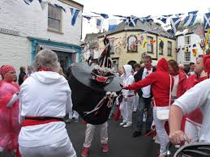
Padstow May Day
https://www.youtube.com/watch?v=7Yol4Y7rdew
https://www.youtube.com/watch?v=Q59KmbPsVuE

Slide 19
Padstow May Day
Unite and unite and let us all unite
For summer is …..
??? a come in today
a-coming today
acome unto day
And whither we are going we will all unite
In the merry morning of May

Slide 20
Padstow May Day
Night song
Unite and unite and let us all unite, For summer is acome unto day, And whither we are going we will all unite, In the merry morning of May.
I warn you young men everyone, For summer is acome unto day, To go to the green-wood and fetch your May home, In the merry morning of May.
Arise up Mr. ..... and joy you betide, For summer is acome unto day, And bright is your bride that lies by your side, In the merry morning of May.
https://www.cornwalls.co.uk/padstow/obby_oss_may_song.htm

Slide 21
Hymns, songs etc
Glady the cross-eyed bear … the cross I’d bear
Old father Whichart Our father, which art …
Harold be thy name hallowed be thy name
Pity mice in pissy tea Pity my simplicity
Four calling birds Four colly birds

Slide 22
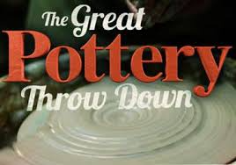
Hymns, songs etc
The first Nowell the angels did say
Was to certain poor shepherds in fields where they lay
Passing hedgerows many and high
People have their uses

Slide 23
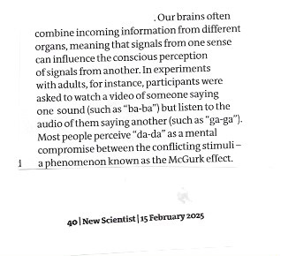
Visual cues

Slide 24
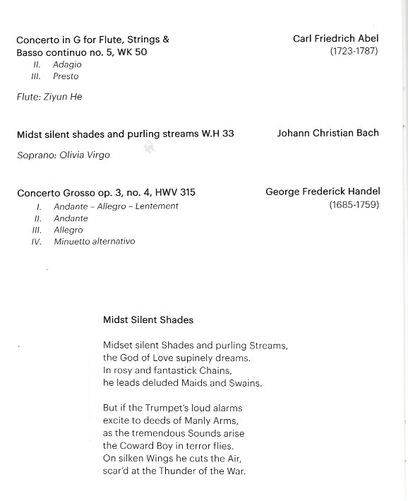
Visual cues

Slide 25
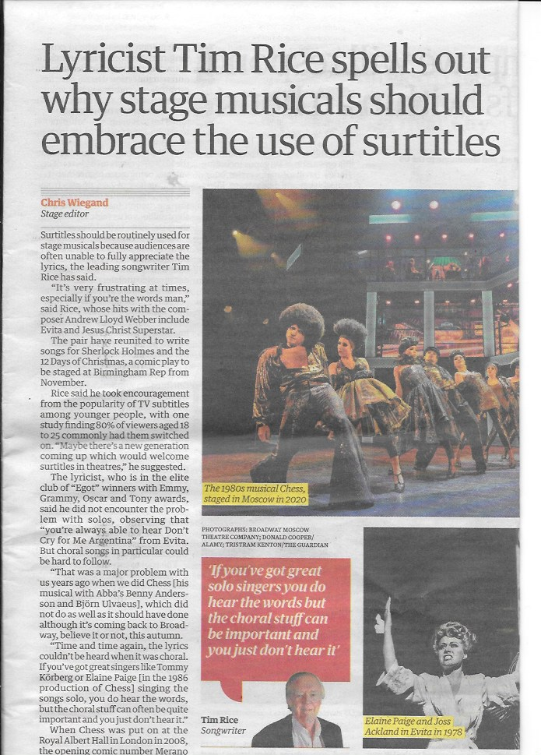
Visual cues
Surtitles should be routinely used for stage musicals because audiences often unable to fully appreciate the lyrics, the leading songwriter Tim Rice has said

Slide 26
Hearing other languages
trays, cattles, cans 13, 14, 15
San fairy Anne Ca ne fait rien
???
Ces anes Cezanne Seize ans

Slide 27
Hearing other languages
blighty
modification of Hindi & Urdu bilātī foreign,
English, alteration of vilāyatī, from vilāyat province, realm, country beyond India, from Persian, dominion,
province, from Arabic wilāya
plonk vin blanc
napoo il n'ya plus
toodle-oo a tout a l'heure

Slide 28
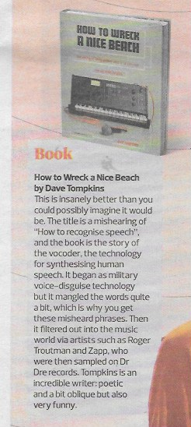
Speech software
How to wreck a nice beach
How to recognise speech
Death Battle
Dear Beryl

Slide 29
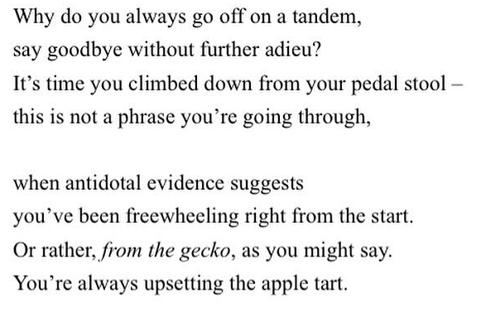
To Be Pacific

Slide 30
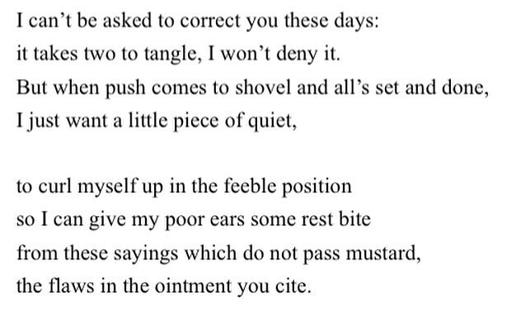

Slide 31
