Slide 1
u3a
10th April 2025
Words from c. 1950
Liz Swinbank et al

Slide 2
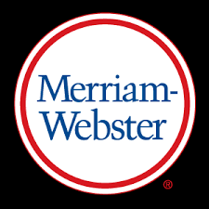
Words from c. 1950
Time Traveler by Merriam-Webster: Words from 1950

Slide 3
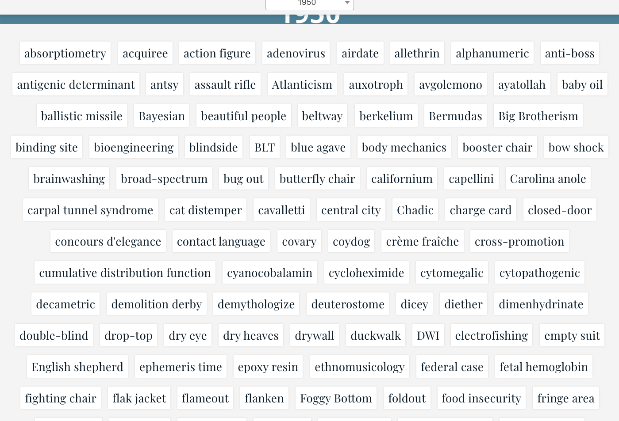

Slide 4
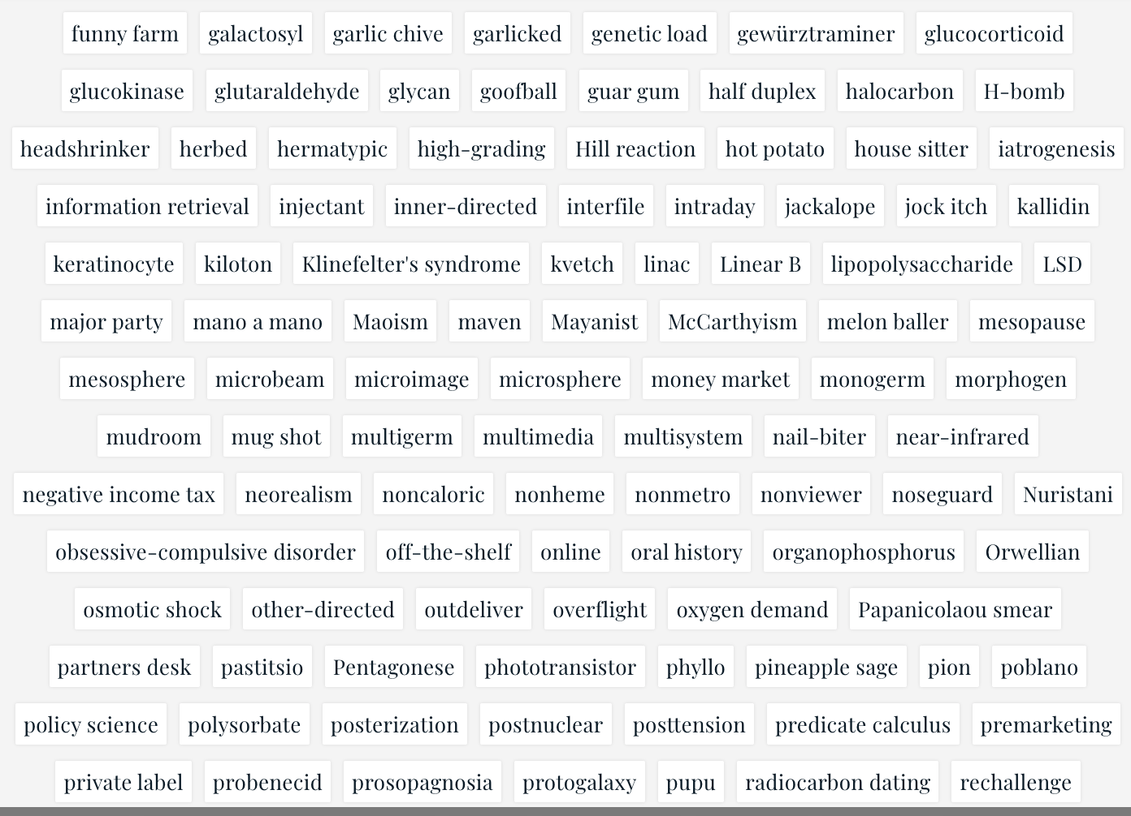

Slide 5
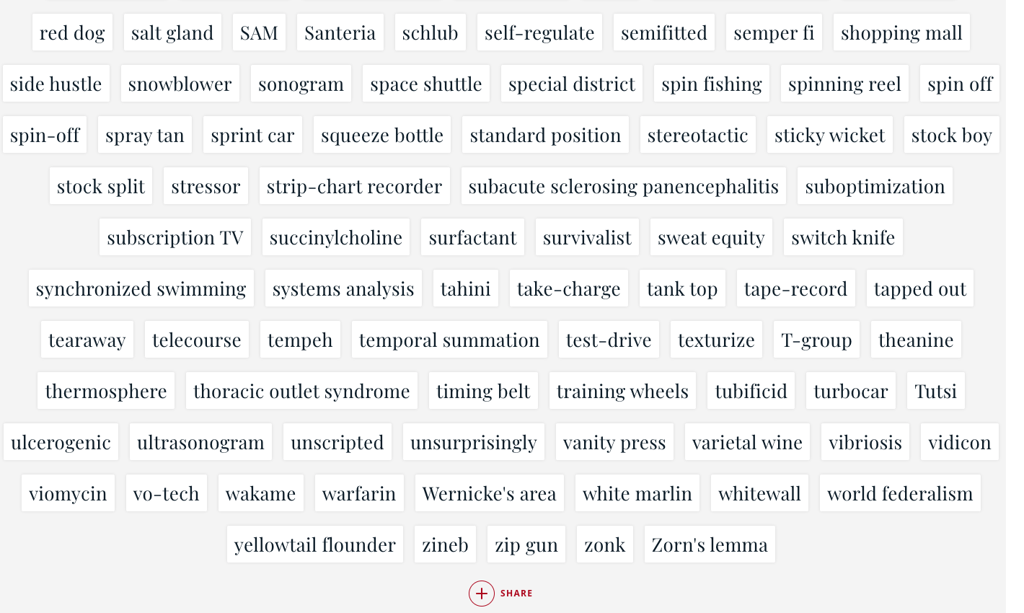

Slide 6
Some of our chosen words
multimedia channel hopping
space shuttle sonogram
global warming Orwellian
hot potato carport
battle dress flame out
bug out nerd
paralympics peloton
jackalope coydog

Slide 7
New uses for animal words in Italian, from the late 1940s and early 1950s -

Slide 8
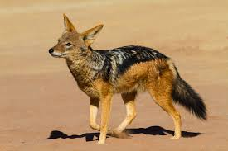
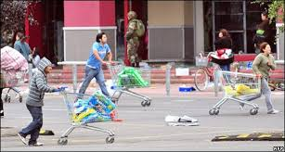
Sciacallo - Jackal
Sciacallo - Looter
...and generally nasty person who takes advantage of very vulnerable people

Slide 9
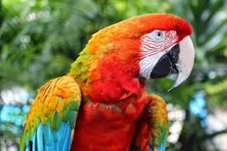
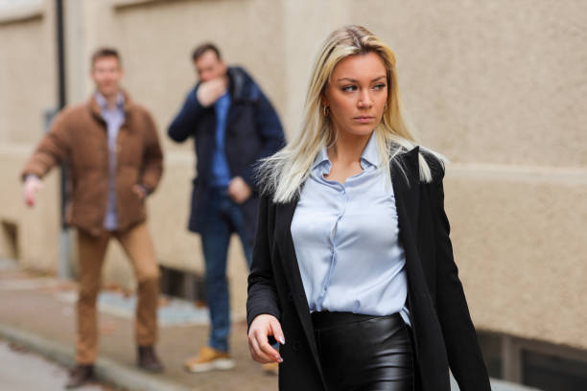
Pappagallo - Parrot
Pappagallo – Man who pesters women

Slide 10
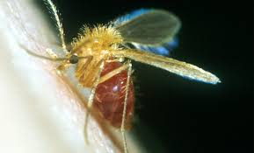
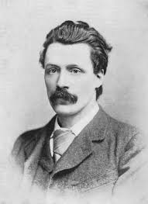
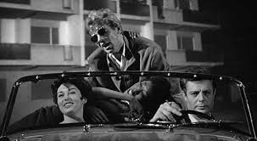
Pappatacio - Sandfly
George Gissing By the Ionian Sea (1901): Coriolano Paparazzo.
Fellini La dolce vita (1960): Paparazzo

Slide 11
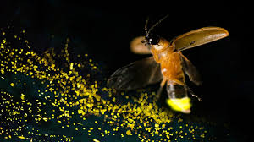
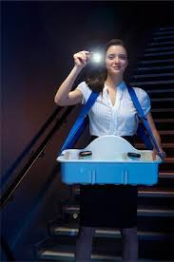
Lucciola – firefly
Lucciola – cinema usher

Slide 12
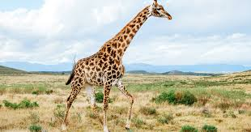
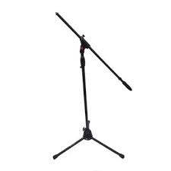
Giraffa – giraffe
Giraffa – crane-type microphone stand

Slide 13
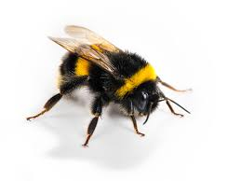
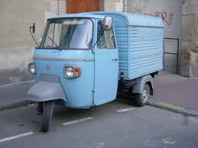
Ape- bee
Ape- make of 3-wheel light van

Slide 14
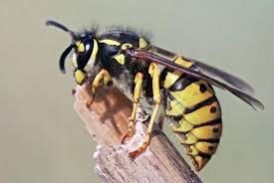
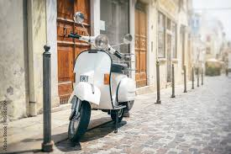
Vespa - wasp
Vespa –make of scooter

Slide 15
My 1950 English word

Slide 16
Nerd
It may have evolved from the word "nert", a 1920s slang term for a dim-witted or crazy person (a play on "nut").
It could be a variation of "knurd" (spelled drunk backward), reportedly used at Rensselaer Polytechnic Institute (RPI) to describe students who studied instead of partying.

Slide 17
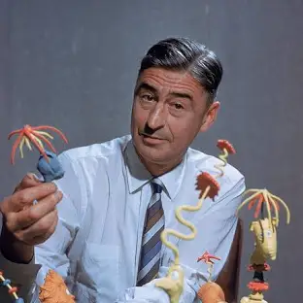
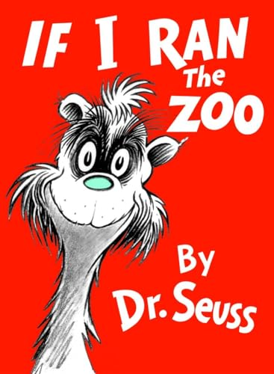
1950
Theodor Geisel
Doctor Seuss
And then, just to show them, I’ll sail to Ka-Troo, And bring back an It-Kutch a Preep and a Proo, A Nerkle, a Nerd and a Seersucker too!

Slide 18
But why do we use it to mean ‘studious person’?

