Slide 1
u3a
11 January 2024
Swearing
Liz Swinbank

Slide 2
Swearing
Definition and etymology
A brief history of swearing
Some recent examples from the media
Benefits of swearing
A universal language

Slide 3
Swear
Verb
make a solemn statement or promise undertaking to do something or affirming that something is the case
use language of a kind regarded as coarse, blasphemous, or otherwise unacceptable in polite or formal speech in order to express anger or other strong emotion
https://languages.oup.com/google-dictionary-en/

Slide 4
Swear
Middle English sweren, from Old English swerian, swerigean English swerian, swerigean, "take or utter an oath, make a solemn declaration with an appeal to divinity" (past tense swor, past participle sworen), from Proto-Germanic swērjanan
Source also of Old Saxon swerian, Old Frisian swera, Old Norse sverja, Danish sverge, Middle Dutch swaren, Old High German swerien, German schwören, Gothic swaren "to swear"
It is related to the second element in answer. A Middle English noun sware meant "an answer, a reply; speech, utterance," from Old English -swaru, and from the Old Norse cognate.
https://www.etymonline.com/word/swear

Slide 5
Swear
The secondary sense of "use profane language" (early 15c.) probably developed from the notion of "invoke sacred names profanely or blasphemously" (mid-14c.).
To swear off "desist, abjure, renounce solemnly, as with a vow" is by 1839. To swear in "install (someone) in office by administration of an oath" is attested from 1700 in modern use, echoing Middle English, where to be sworn was to be admitted to office by formal oath (c. 1200).
To swear by is from early 13c., originally in reference to a divine being or sacred object; the colloquial sense of "treat as an infallible authority, place great confidence in" is by 1815.
https://www.etymonline.com/word/swear

Slide 6
[Swearing and cursing] are entirely different things : the first is invoking the witness of a Spirit to an assertion you wish to make ; the second is invoking the assistance of a Spirit, in a mischief you wish to inflict. When ill-educated and ill-tempered people clamorously confuse the two invocations, they are not, in reality, either cursing or swearing ; but merely vomiting empty words indecently. True swearing and cursing must always be distinct and solemn ....
John Ruskin, Fors Clavigera 1871
Fors Clavigera: Letters to the Workmen and Labourers of Great Britain was a series of letters addressed to British workmen during the 1870s.

Slide 7
Swear words
Usually …
Short 1 or 2 syllables
Strong consonants B, D, F, G, K, S …
Relate to religion
body parts and functions (excretion or sex)

Slide 8
Swear words
Some once-taboo words have become acceptable …
Oh my God!
Damn Blast Bloody
In a copy of Vanity Fair in the early 20th century, the word ‘damn’ was disguised with dashes

Slide 9
Bloody
mid 17th cent.: from bloody². The use of bloody to add emphasis to an expression is of uncertain origin, but is thought to have a connection with the “bloods” (aristocratic rowdies) of the late 17th and early 18th centuries; hence the phrase bloody drunk (= as drunk as a blood) meant “very drunk indeed”. After the mid 18th cent. until quite recently bloody used as a swear word was regarded as unprintable, probably from the mistaken belief that it implied a blasphemous reference to the blood of Christ, or that the word was an alteration of “by Our Lady”; hence a widespread caution in using the term even in phrases, such as bloody battle, merely referring to bloodshed.
https://www.oxfordlearnersdictionaries.com/definition/english/bloody1

Slide 10
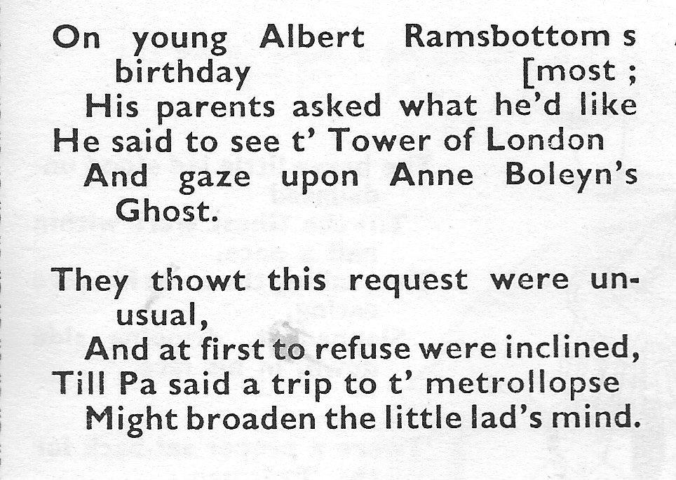
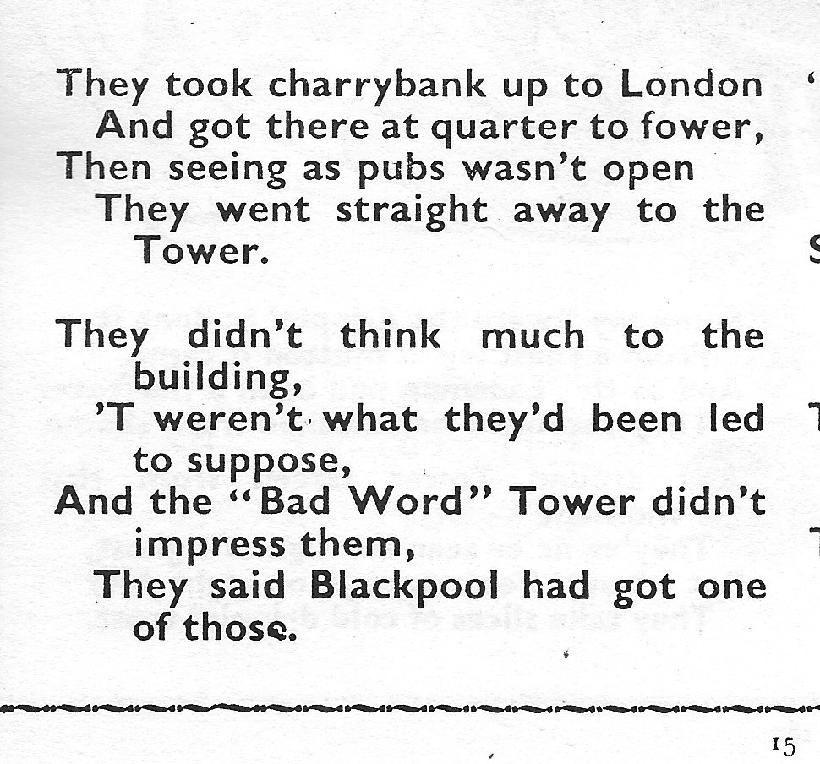
From Albert and the ‘eadsman
Marriott Edgar (1880-1951)

Slide 11
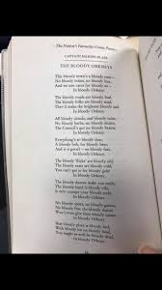
Bloody Orkney
This bloody town’s a bloody cuss
No bloody trains, no bloody bus,
And no one cares for bloody us
In bloody Orkney
…
Captain Hamish Blair, stationed in Orkney in WW II
https://www.youtube.com/watch?v=bgaNqDaBUwU

Slide 12
Swear words
Some once-taboo words have become acceptable …
Oh my God!
Damn Blast Bloody
… and vice versa

Slide 13
A brief history of swearing
Exodus Ch 20, vv 1-17
…
3 Thou shalt not take the name of the Lord thy God in vain
…

Slide 14
Holy Sh*t: a Brief History of Swearing
Melissa Mohr - A review
“A helpful and interesting chapter on ancient Roman filth does much to sketch the background, too. How do we know what was obscene in a dead language? By literary genre, essentially: if it was written on the toilet wall but didn't appear in satire, it was likely to be properly rude. …The Romans had a "Big 10”: cunnus (cunt), futuo (fuck), mentula (cock), verpa (erect or circumcised cock), landica (clitoris) culus (arse), pedico (bugger), caco (shit), fello (fellate) and irrumo (er, mouth-rape).
“ … the Romans, like us, had a primary relationship between the body and the idea of obscenity.”
https://www.theguardian.com/books/2013/may/23/holy-shit-history-swearing-mohr

Slide 15
Holy Sh*t: a Brief History of Swearing
Melissa Mohr - A review
“In medieval times, though, the emphasis was all on the holy. Common words for places and things contained vulgarities regarded as quite innocuous. London and Oxford both boasted a "Gropecuntelane", which is where the prostitutes hung out,
“… it's hard to recapture quite how shocking medieval people would find a vain oath. ... To swear an oath was to compel God to pay attention to your promise – and to do so in vain was to dishonour God and risk eternal damnation. Indeed, it was believed that if you swore on God's body – "'sblood!"; "God's bones!"; "by Christ's nails!" – you physically spilled his blood, broke his bones and tore out his nails in heaven. ”
https://www.theguardian.com/books/2013/may/23/holy-shit-history-swearing-mohr

Slide 16
Holy Sh*t: a Brief History of Swearing
Melissa Mohr - A review
“One word was regarded in the late-18th and 19th centuries as so shocking that it was variously rendered "inexpressibles", "indescribables", "etceteras", "unmentionables", "ineffables", "indispensables", "innominables" "inexplicables" and "continuations".
That word? "Trousers."
https://www.theguardian.com/books/2013/may/23/holy-shit-history-swearing-mohr

Slide 17
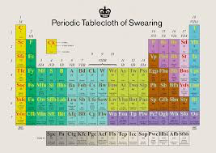
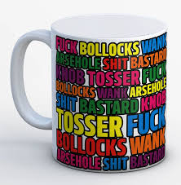
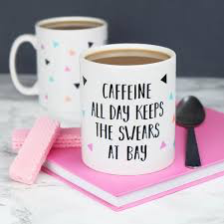

Slide 18
Some recent examples
“Does anyone ever say: ‘You know what, you’ve done a fucking good job, because everyone else has sat on their arse and done nothing?’ No signs of that, no?”
Gillian Keegan, Education Secretary, September 2023

Slide 19
Some recent examples
“Does anyone ever say: ‘You know what, you’ve done a fucking good job, because everyone else has sat on their arse and done nothing?’ No signs of that, no?”
Gillian Keegan, Education Secretary, September 2023
“What was interesting was the “should we, shouldn’t we” deployment of asterisks. Some news outlets (including ITV, the primary source) used decorous bleeping for the clip itself and deployed quaint asterisks in print – demure little clutches of pearls in the f***ing and the a***.”
Ian Martin The Observer, 10th September 2023
https://www.theguardian.com/commentisfree/2023/sep/10/brits-have-a-rich-swearing-heritage-lets-follow-gillian-keegans-lead

Slide 20
Some recent examples
“When you think about the family, it’s about stability. Most of the kids who struggle in Bury are the products of crap parents ...”
James Daly, Conservative MP for Bury North,
interviewed in the i newspaper, 28 December 2023

Slide 21
Some recent examples
Stockton North MP Alex Cunningham asked Rishi Sunak why 34% of children in his area were living in poverty.
Cunningham and other Labour MPs said they heard James Cleverly, who was sitting on the government frontbench, mutter “it’s a shithole”.
An audio recording also appeared to pick up a male voice saying that word, but despite sources close to the minister initially insisting he said nothing, they later said he had actually called Cunningham “a shit MP”.

Slide 22
Swearing has become more widely acceptable over the past two decades because it is increasingly used for other purposes than to insult people, linguistics experts have said.
“Fuck” and “shit”, the two most commonly used swearwords in the UK, are frequently used to emphasise a point in conversation or to build social bonds, rather than with the specific intent to cause offence, according to academic researchers.
They made the comments after the BBC presenter Mishal Husain swore seven times in under a minute during an interview with the home secretary, James Cleverly.
https://www.theguardian.com/media/2024/jan/06/swearing-is-becoming-more-widely-acceptable-linguistics-experts-claim

Slide 23
Benefits of swearing
Why swearing is a sign of intelligence, helps manage pain and more
By Sandee LaMotte, CNN 1 June 2023
https://edition.cnn.com/2021/01/26/health/swearing-benefits-wellness/index.html

Slide 24
1 Cursing may be a sign of intelligence
Participants were asked to list as many words that start with F, A or S in one minute. Another minute was devoted to coming up with curse words that start with those three letters. The study found those who came up with the most F, A and S words also produced the most swear words.
That’s a sign of intelligence “to the degree that language is correlated with intelligence,” said Timothy Jay, a professor of psychology at Massachusetts College of Liberal Arts, who authored the study. “People that are good at language are good at generating a swearing vocabulary.”

Slide 25
2 Swearing may be a sign of honesty
People who cursed lied less on an interpersonal level, and had higher levels of integrity overall, a series of three studies published in 2017 found.
“When you’re honestly expressing your emotions with powerful words, then you’re going to come across as more honest,” said Jay, who was not involved in the studies.
While a higher rate of profanity use was associated with more honesty, the study authors cautioned that “the findings should not be interpreted to mean that the more a person uses profanity, the less likely he or she would engage in more serious unethical or immoral behaviors.”

Slide 26
3 Profanity improves pain tolerance
People on bikes who swore while pedalling against resistance had more power and strength than people who used “neutral” words, studies have shown.
Research also found that people who cursed while squeezing a hand vice were able to squeeze harder and longer.
Spouting obscenities doesn’t just help your endurance: If you pinch your finger in the car door, you may well feel less pain if you say “sh*t” instead of “shoot.”
Another study found people who cursed as they plunged their hand into icy water felt less pain and were able to keep their hands in the water longer than those who said a neutral word.
…

Slide 27
3 Profanity improves pain tolerance
…
Psychologist Richard Stephens, the lead author of the three studies, researches swearing at the Psychobiology Research Laboratory at Keele University in Staffordshire, England.
Stephens says it works like this: swearing produces a stress response that initiates the body’s ancient defensive reflex. A flush of adrenaline increases heart rate and breathing, prepping muscles for fight or flight.
Simultaneously, there is another physiological reaction called an analgesic response, which makes the body more impervious to pain.
Careful, however, the next time you decide to extend your workout by swearing. Curse words lose their power over pain when they are used too much, research has also discovered.

Slide 28
4 Cussing is a sign of creativity
Research on swearing dates back to Victorian times, when physicians discovered that patients who lost their ability to speak could still curse.
Swearing appears to be centred in the right side of the brain, the part people often call the “creative brain.”
“We do know patients who have strokes on the right side tend to become less emotional, less able to understand and tell jokes, and they tend to just stop swearing even if they swore quite a lot before,” said Emma Byrne, author of “Swearing Is Good for You.”

Slide 29
Coprolalia and Tourette’s
Coprolalia, the involuntary utterance of obscenities, profanities and derogatory remarks, is an extreme example of a vocal tic experienced by some people with Tourette's. When the compulsion overcomes them, sufferers of the condition cannot help yelling inappropriate or culturally taboo remarks or phrases
https://tourette.org/resource/understanding-coprolalia/

Slide 30
5 Throwing expletives instead of punches
“A dog or a cat will scratch you, bite you when they’re scared or angry,” Jay said. “Swearing allows us to express our emotions symbolically without doing it tooth and nail.
“In other words, I can give somebody the finger or say f**k you across the street. I don’t have to get up into their face.”
Cursing then becomes a remote form of aggression, he said, offering the chance to express feelings quickly while hopefully avoiding repercussions.

Slide 31
A universal language
It’s not just people who swear. Even primates curse when given the chance.
“Chimpanzees in the wild tend to use their excrement as a social signal, one that’s designed to keep people away,” Byrne said.
Hand-raised chimps who were potty-trained learned sign language for “poo” so they could tell their handlers when they needed the toilet.
“Chimpanzees in the wild tend to use their excrement as a social signal, one that’s designed to keep people away,” Byrne said. “And as soon as they learned the poo sign they began using it like we do the word s**t.”
https://edition.cnn.com/2021/01/26/health/swearing-benefits-wellness/index.html

Slide 32
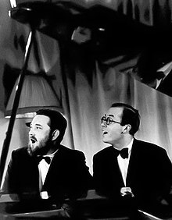
… and finally
Ma's out, Pa's out, let's talk rude-- Pee, po, belly, bum, drawers! Dance in the garden in the nude Pee, po, belly, bum drawers! …
Michael Flanders and Donald Swann
1 January 1964
“a song comparing the use of profanity among the intelligentsia to playground swearing”
https://www.youtube.com/watch?v=eSrXqOI9988

Slide 33
Ma's out, Pa's out, let's talk rude-- Pee, po, belly, bum, drawers! Dance in the garden in the nude Pee, po, belly, bum drawers!
Let's write rude words all down our street Stick out our tongues at the people we meet Let's have an intellectual treat! Pee, po, belly, bum, drawers Sunday again on CBC Pee, po, belly, bum, drawers And Norman Mailer is coming to tea Pee, po, belly, bum, pants! Allen Ginsberg reads on and on We’re having a happening when he's gone Come to the party in the john Pee, po, belly, bum, drawers
Disney's planning a double bill-- Pee, po, belly, bum, drawers-- Christopher Robin meets Fanny Hill Pooh Bear, belly, bum, drawers!
On stage and screen we can all work hard Throwing toilet rolls in our own backyard Who's afraid of the avant-garde? Pee, pee, po, po, belly, belly, bum, bum Pee, po, belly, bum, drawers What gets the prizes and wins awards? Pee! Po! Belly! Bum! Drawers!
What did Prince Philip tell the Lords?
Well never mind that!
At Oxford and Cambridge and Yale and all,
And at Berkely they really have a ball;
′Cause the higher the brow, the harder they fall
For Belly-belly! Bum-bum!
Potty-potty! Bum! Pee! Po!
Belly-belly! Bum-bum!
Pee! Po! Belly! Bum! Drawers!

