Slide 1
u3a
12 December 2024
Weather and seasons
Liz Swinbank et al

Slide 2
Weather and seasons
Let’s talk about the weather
Some (dialect?) weather words
Weather sayings in English and other languages
Sky
And now for the weather
Winter’s song
50(?) Inuit words for snow
A song of weather

Slide 3
Let’s talk about the weather
The Pirates of Penzance
W S Gilbert & Arthur Sullivan
1879
https://www.youtube.com/watch?v=a3gooGhFH2E

Slide 4
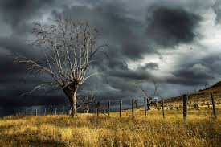
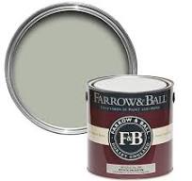
Some (dialect?) weather words
Dreich
Blowing a hooley
Pea-souper
Sea fret, haar
Mizzle

Slide 5
Weather sayings
Storm in a teacup
Raining cats and dogs
Ne'er cast a clout till May is out
Brass monkeys
…

Slide 6
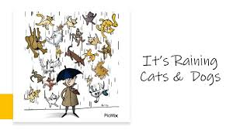

Slide 7
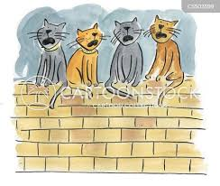
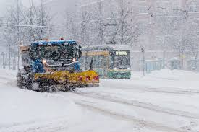
CATS
Katzenjammerwetter
Lumi sataa kissan kokoisina

Slide 8
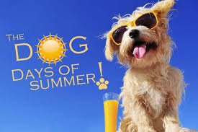
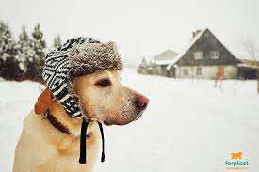
DOGS
DOG DAYS
LA CANICULE
CALOR DE PERROS
UN FREDDO CANE
Мороз собачий

Slide 9
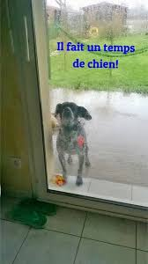
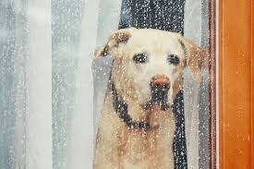
DOGS
IL FAIT UN TEMPS DE CHIEN
Hundväder

Slide 10
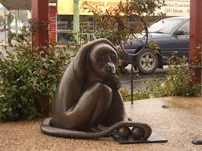
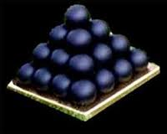
OTHER ANIMALS
BRASS MONKEYS
AFFENKALT
AFFENSTARK AFFENSCHNELL

Slide 11
OTHER ANIMALS
IL FAIT UN FROID DE CANARD
IL FAIT UN FROID DE LOUP

Slide 12
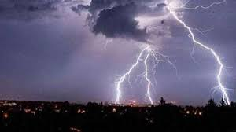
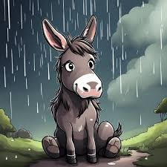
OTHER ANIMALS
மழை நாய் பூனை மாதிரி முளை
(Rain and thunder are like rats fighting)
Está um tempo de burro

Slide 13
Madrid: nueve meses de invierno, tres de infierno
Llover sobre mojado
Llanto de niño, lluvia de estío; llanto de viejo, lluvia de invierno

Slide 14
Si las lombrices asoman en el huerto, se moja presto Cuando el búho en diciembre canta, o lluvia o templanza ¡Hace un frío que pela!

Slide 15
Hace un frío de perros
¡Está cayendo la del pulpo!

Slide 16
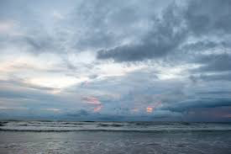
Sky
From Pat
My mother used to say
when it was cloudy or
raining....
"Don't worry, there's blue sky underneath."
Enough blue to make a sailor a pair of trousers
… to make a Dutchman’s pants
… to make a cat a pair of trousers

Slide 18
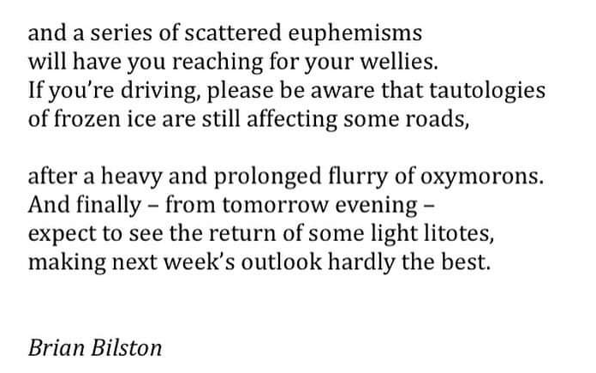

Slide 19
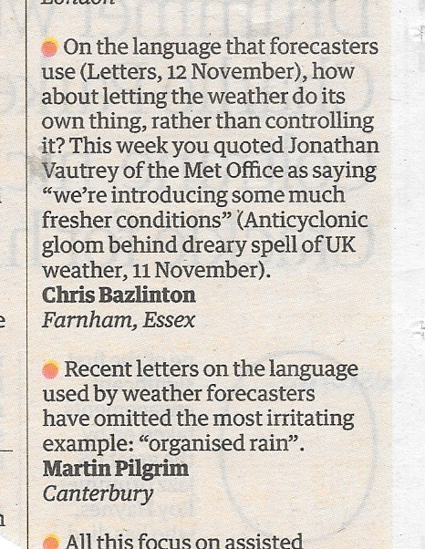
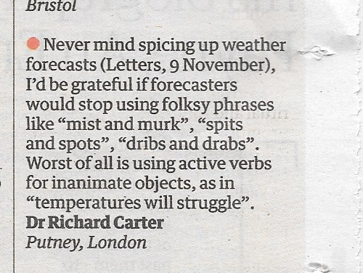
Forecasts
The Guardian, November 2024

Slide 20
Winter’s song
When icicles hang by the wall,
And Dick the shepherd blows his nail,
And Tom bears logs into the hall,
And milk comes frozen home in pail,
When blood is nipp’d, and ways be foul,
Then nightly sings the staring owl:
‘Tu-who;
Tu-whit, Tu-who’ – A merry note,
While greasy Joan doth keel the pot.

Slide 21
Winter’s song
When all aloud the wind doth blow,
And coughing drowns the parson’s saw,
And birds sit brooding in the snow,
And Marian’s nose looks red and raw,
When roasted crabs hiss in the bowl,
Then nightly sings the staring owl:
‘Tu-who;
Tu-whit, Tu-who’ – A merry note,
While greasy Joan doth keel the pot.
William Shakespeare, Love’s Labours Lost, mid 1590s

Slide 22
Winter’s song
When snow is deep, frost every day,
Storms Bert and Darragh bring gales and deadly seas,
Broken roofs, cars washed away,
Uprooting folk as well as trees,
It's freezing cold and ways be foul
But still we hear that pesky owl!
But no - it's Keir we hear
Bringing his words of Christmas cheer -
To you, to you, to me and you, and greasy Joan,
A merry note,
There is no money in the pot!
Lesley Woodfield, 2024

Slide 23
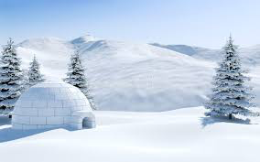
50(?) Inuit words for snow

Slide 24
50(?) Inuit words for snow
The original claim is loosely based in the work of anthropologist Franz Boas, and was particularly promoted by his contemporary, Benjamin Lee Whorf. Boas studied the local Inuit people of Baffin Island, Canada in the late 1800s as part of his postgraduate geography studies.
Boas did not make quantitative claims but rather pointed out that the Eskaleut languages have about the same number of distinct word roots referring to snow as English does, with the structure of these languages tending to allow more variety as to how those roots can be modified in forming a single word. Where in the English language we might have a sentence describing snow, fusional languages such as the Eskimo-Aleut family will have long, complex words.

Slide 25
50(?) Inuit words for snow
Some Eskimo-Aleut snow lexemes:
qanuk: ‘snowflake’
kaneq: ‘frost’
kanevvluk: ‘fine snow’
qanikcaq: ‘snow on ground’
muruaneq: ‘soft deep snow’
nutaryuk: ‘fresh snow’
pirta: ‘blizzard’
qengaruk: ‘snow bank’
https://en.wikipedia.org/wiki/Eskimo_words_for_snow
https://readable.com/blog/do-inuits-really-have-50-words-for-snow/

Slide 26
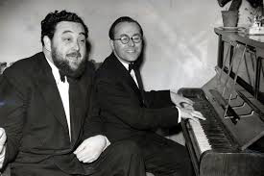
A song of weather
https://www.youtube.com/watch?v=1qV-VO5eXOA
At the Drop of a Hat, 1956-61

Slide 27
A song of weather
January brings the snow
Makes your feet and fingers glow
February's ice and sleet
Freeze the toes right off your feet
Welcome March with wintry wind
Would thou wert not so unkind
April brings the sweet Spring showers
On and on for hours and hours
Farmers fear unkindly May
Frost by night and hail by day
June just rains and never stops
Thirty days and spoils the crops

Slide 28
A song of weather
In July the sun is hot
Is it shining? No, it's not
August cold and dank and wet
Brings more rain than any yet
Bleak September's mist and mud
Is enough to chill the blood
Then October adds a gale
Wind and slush and rain and hail
Dark November brings the fog
Should not do it to a dog
Freezing wet December then
Bloody January again

