Slide 1
u3a
14 November 2024
CAPITALS and other cases
Liz Swinbank

Slide 2
CAPITALS and other cases
A brief history
Capitalisation in English and in other languages
Does case matter?
Capitals in emails etc
Road signs
Scientific notation
ALL CAPS, no caps, camel, snake …

Slide 3
CAPITALS and other cases
Letter case is the distinction between the letters that are in larger uppercase or capitals (more formally majuscule) and smaller lowercase (more formally minuscule) in the written representation of certain languages.
https://en.wikipedia.org/wiki/Letter_case
https://en.wikipedia.org/wiki/Roman_cursive
https://medium.com/@sonderlingpress/why-do-we-have-uppercase-and-lowercase-letters-a-snarky-history-lesson-31e44cddd168

Slide 4
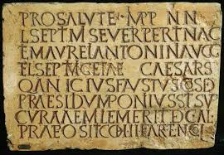
A brief history
Before the development of lower-case letters, texts in the Latin alphabet were written in a single case

Slide 5
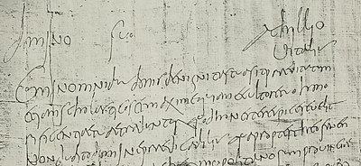
A brief history
Roman cursive (or Latin cursive) is a form of handwriting (or a script) used in ancient Rome and to some extent into the Middle Ages. It is customarily divided into old (or ancient) cursive and new cursive.

Slide 6
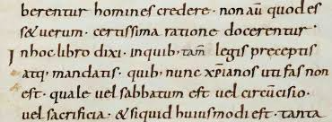
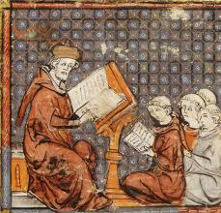
A brief history
Alcuin of York is credited with developing Carolingian minuscule in the 8th century

Slide 7
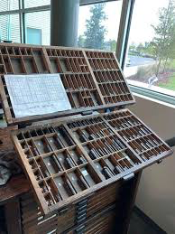
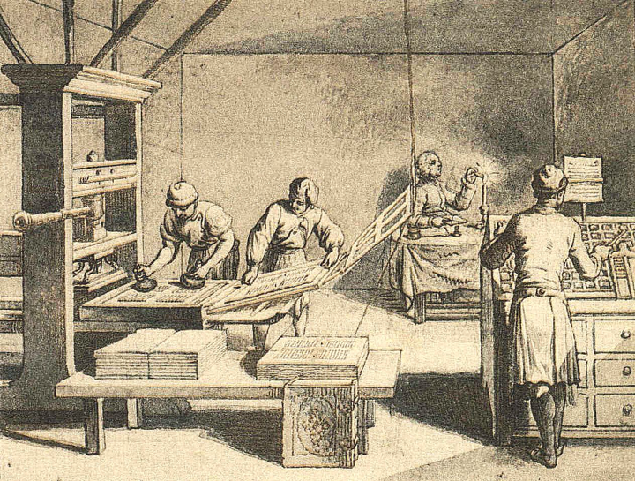
A brief history
Following the invention of the printing press in the 15th century, majuscule and minuscule became known as uppercase and lowercase

Slide 8
A minority of writing systems use two separate cases. Such writing systems are called bicameral scripts.
These scripts include
Latin Cyrillic Greek Coptic
Armenian Glagolitic Adlam Warang Citi
Garay Zaghawa Osage Vithkuqi
Deseret
All other writing systems make no distinction between majuscules and minuscules – a system called unicameral script or unicase. This includes most syllabic and other non-alphabetic scripts.

Slide 9
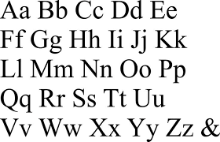
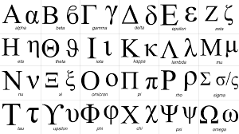

Slide 10
Capitalisation in English
Letter case is generally applied in a mixed-case fashion, with both upper and lowercase letters appearing in a given piece of text for legibility.
In orthography, the uppercase is reserved for special purposes, such as the first letter of a sentence or of a proper noun (called capitalisation, or capitalised words), which makes lowercase more common in regular text.
In some contexts, it is conventional to use one case only. For example, engineering design drawings are typically labelled entirely in uppercase letters, which are easier to distinguish individually than the lowercase when space restrictions require very small lettering.

Slide 11
… in English
"... we are living in a Christian country and I think first and foremost they should have a good grounding in Holy Scripture and a sound knowledge of Jesus. It is so important that children know about Him and His works. Archdeacon Richards was only telling me last week that he was addressing an assembly at a school in Fettlesham and was telling the children that Jesus had risen from the dead and had returned to see His disciples. He asked the children if they knew what words Jesus had spoken when He walked through the door to face His apostles... "
Gervase Phinn, The Heart of the Dales, pub. Michael Joseph 2007

Slide 12
Capital offenders: the case against uppercase
…
The Guardian style guide has long encouraged the gradual move away from capitals. So do other newspapers and websites, although some venerable style guides are still agonising over whether to lowercase internet and world wide web. (Be assured they will do so, perhaps in time for the 22nd century.)
In part, the switch from capitals reflects a society that is less deferential than in the days when the Manchester Guardian would write something like this: "The CHANCELLOR OF THE EXCHEQUER, Mr LLOYD GEORGE, presented the Naval Estimates to Ministers and Members of the House.”
Most readers seem comfortable with a less formal style. A grand total of two people complained about our coverage of the pope's, rather than the Pope's, recent visit to the UK.

Slide 13
We did receive a letter last week complaining that calling David Cameron the prime minister, not the Prime Minister (a style we have been following for more than a decade) reflected a "lowering of standards", but such complaints are few.
We need to be ever-vigilant, however, against the capital offenders. Politicians, civil servants and Estate Agents are three groups that remain intent on drowning us all in this alphabet soup. (Yesterday I was presented with a government statement that said: "On the Chancellor's recommendation the Prime Minister has appointed the Secretary of State for Energy and Climate Change to the Public Expenditure Committee ... ")
David Marsh, The Guardian, October 2010
https://www.theguardian.com/media/mind-your-language/2010/oct/04/new-york-street-signs-capitals

Slide 14
… in German
All nouns have an initial capital.
The German personal pronoun "Sie" [formal or plural “you”] must be capitalized.
Spelling reform logically left the formal Sie and its related forms (Ihnen,Ihr) capitalized, but called for the informal, familiar forms of "you" (du,dich, ihr, euch, etc.) to be in lower case letters.
Adjectives — including those of nationality — are generally not capitalized. Exceptions include legal, geographical and historical terms, official titles … e.g. der Nahe Osten (the Middle East).

Slide 15
… in French
The use of capital letters (les majuscules) is much less common in French than in English.
Days of the week and months of the year are not capitalized in French.
Geographical words used with proper names are not capitalized in French.
In French, languages are never capitalized
Whether used as nouns or adjectives, most words related to the names of religions are not capitalized in French

Slide 16
 | en francais | in English | auf Deutsch
 | Marie Dupont, Dijon | Jane Robinson, York | Anna Schmidt, Munster
 | jeudi novembre | Thursday November | Donnerstag November
 | je, tu, il, elle nous, vous, ils, elles | I, you, he, she, we, you, they | ich, du, er, sie wir, Sie, sie
 | thé, café, biscuits | tea, coffee, biscuits | Tee, Kaffee, Kekse
 | une bière allemagne | a German beer | ein deutches Bier

Slide 17
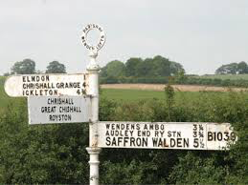
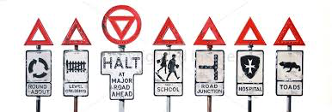

Slide 18
Road signs
Mile-a-minute typography
This was the title of the series of photos graphic designer Herbert Spencer in his magazine Typographica in 1961.
Spencer drove from central London to Heathrow airport and took pictures of every road sign he saw along the way. The photos showed how confusing signs were at the time - each one used different typefaces, symbols and colours. The number of cars on the road was increasing and it was obvious that Britain needed an understandable and easy to read system of road signs.

Slide 19
Road signs
A 1955 study by Miles Tinker showed that "all-capital text retarded speed of reading from 9.5 to 19.0 percent for the 5 and 10-minute time limits, and 13.9 percent for the whole 20-minute period". Tinker concluded that, "Obviously, all-capital printing slows reading to a marked degree in comparison with Roman lower case.”
According to Tinker, "As early as 1914, Starch reported that material set in Roman lower case was read somewhat faster than similar material printed in all capitals." Another study in 1928 showed that "all-capital text was read 11.8 percent slower than lower case, or approximately 38 words per minute slower", and that "nine-tenths of adult readers consider lower case more legible than all capitals".
https://en.wikipedia.org/wiki/All_caps

Slide 20
Road signs
The road signage system created by London designers Jock Kinneir and Margaret Calvert was launched and used on all British roads on 1 January 1965.
Kinneir and Calvert designed the Motorway and Transport typefaces to use on all signs. Both mix upper and lower-case letters which helps people recognise words faster than when they are written using only capital letters.
https://designmuseum.org/discover-design/all-stories/british-road-signs.

Slide 21
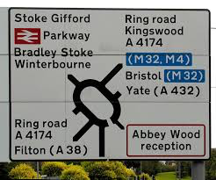
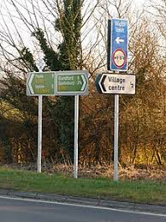
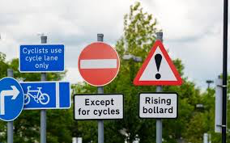

Slide 22
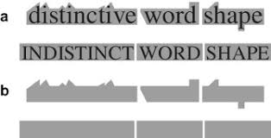
Does case matter?

Slide 23
Scientific notation
The full name of a unit is always printed in lower case roman (upright) type.
If that name is derived from a proper name then its abbreviation is a one or two letter symbol whose first letter is capitalized.
The symbol for a unit whose name is not derived from a proper name is printed in lower case roman type.
Examples:-
joule, J, kelvin, K hertz, Hz metre, m
https://archive2.iupap.org/wp-content/uploads/2014/05/A4.pdf

Slide 24
Scientific notation
In writing unit prefixes it is important to distinguish between upper and lower case.
For example:-
A laser pointer should have a power less than 1 mW
A generating unit at Drax power station produces about 660 MW

Slide 26
Scientific notation
Symbols for physical quantities and symbols for numerical variables should be printed in italic (sloping) type. For example:-
the mass is 50 kilograms m = 50 kg
the distance is 100 metres d = 100 m
the energy is 200 joules E = 200 J
the power is 1 milliwatt P = 1 mW
the power is 660 megawatts P = 660 MW

Slide 27
Does case matter?
Capitals in emails etc
Passwords are usually case sensitive
eg MyPassWord
is not the same as mypassword
but email addresses are not
eg JANE.SMITH@EMAIL.COM
is the same as jane.smith@email.com

Slide 28
Does case matter?
Capitals in emails etc
Many websites give advice about using capitals in email:-
Do not use ALL capital letters to emphasize or highlight your message. This is considered to be rude, and can be interpreted as shouting at someone in terms of email etiquette.
One of the biggest mistakes is overusing capital letters throughout the subject line. This can make your email appear spammy and unprofessional. Instead, use capitalization strategically and sparingly to enhance key words and phrases.

Slide 29
Capital, italic, bold …
Italic type was first used by Aldus Manutius and his press in Venice in 1500. Manutius intended his italic type to be used not for emphasis but for the text of small, easily carried editions of popular books (often poetry), replicating the style of handwritten manuscripts of the period.
The modern Latin-alphabet system of fonts appearing in two standard weights, with the styles being regular (or "Roman"), italic, bold and bold italic is a relatively recent development, dating to the early twentieth century. Modern "Roman" type was developed around the 1470s, while italic type was developed around 1500 and was commonly used for emphasis by the early 17th century. Bold type did not arrive until the nineteenth century, and at first fonts did not have matching bold weights; instead a generic bold, sometimes a Clarendon or other kind of slab-serif, would be swapped in.
https://en.wikipedia.org/wiki/Emphasis_(typography)
https://en.wikipedia.org/wiki/Italic_type

Slide 30
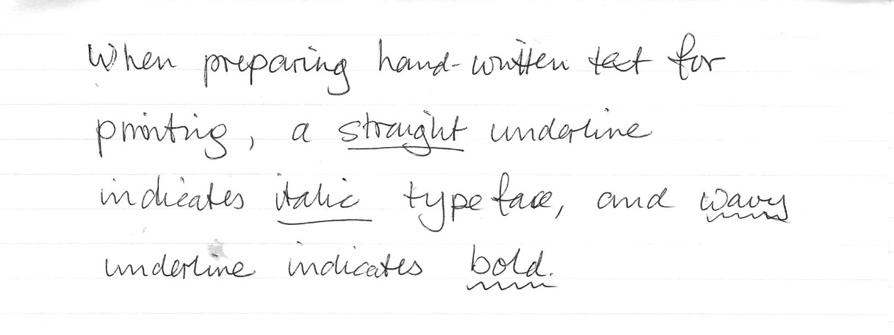
Capital, italic, bold …
When preparing hand-written text for printing, a straight underline indicates italic typeface, and wavy underline indicated bold.

Slide 31
no capitals
a total stranger one black day
knocked living the hell out of me--
who found forgiveness hard because
my(as it happened)self he was
-but now that fiend and i are such
a total stranger one black day
e e cummings

Slide 32
anyone lived in a pretty how town (with up so floating many bells down) spring summer autumn winter he sang his didn't he danced his did women and men (both little and small) cared for anyone not at all they sowed their isn't they reaped their same sun moon stars rain
e e cummings
From "anyone lived in a pretty how town" (1940)

Slide 33
Edward Estlin Cummings (October 14, 1894 – September 3, 1962), commonly known as e e cummings or E. E. Cummings, was an American poet, painter, essayist, author, and playwright.
Cummings wrote approximately 2,900 poems. He is often regarded as one of the most important American poets of the 20th century. He is associated with modernist free-form poetry, and much of his work uses idiosyncratic syntax and lower-case spellings for poetic expression
https://en.wikipedia.org/wiki/E._E._Cummings

Slide 34
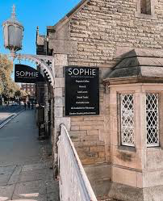
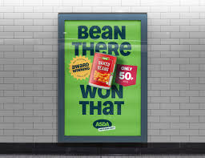
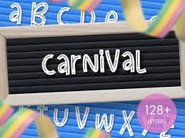
Mixed cases

Slide 35
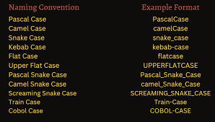
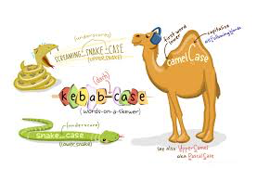
Mixed cases

